Slide 1
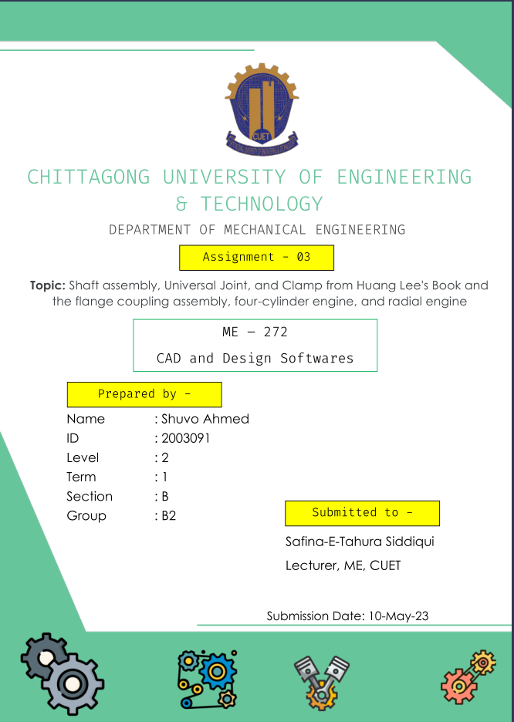

Slide 2
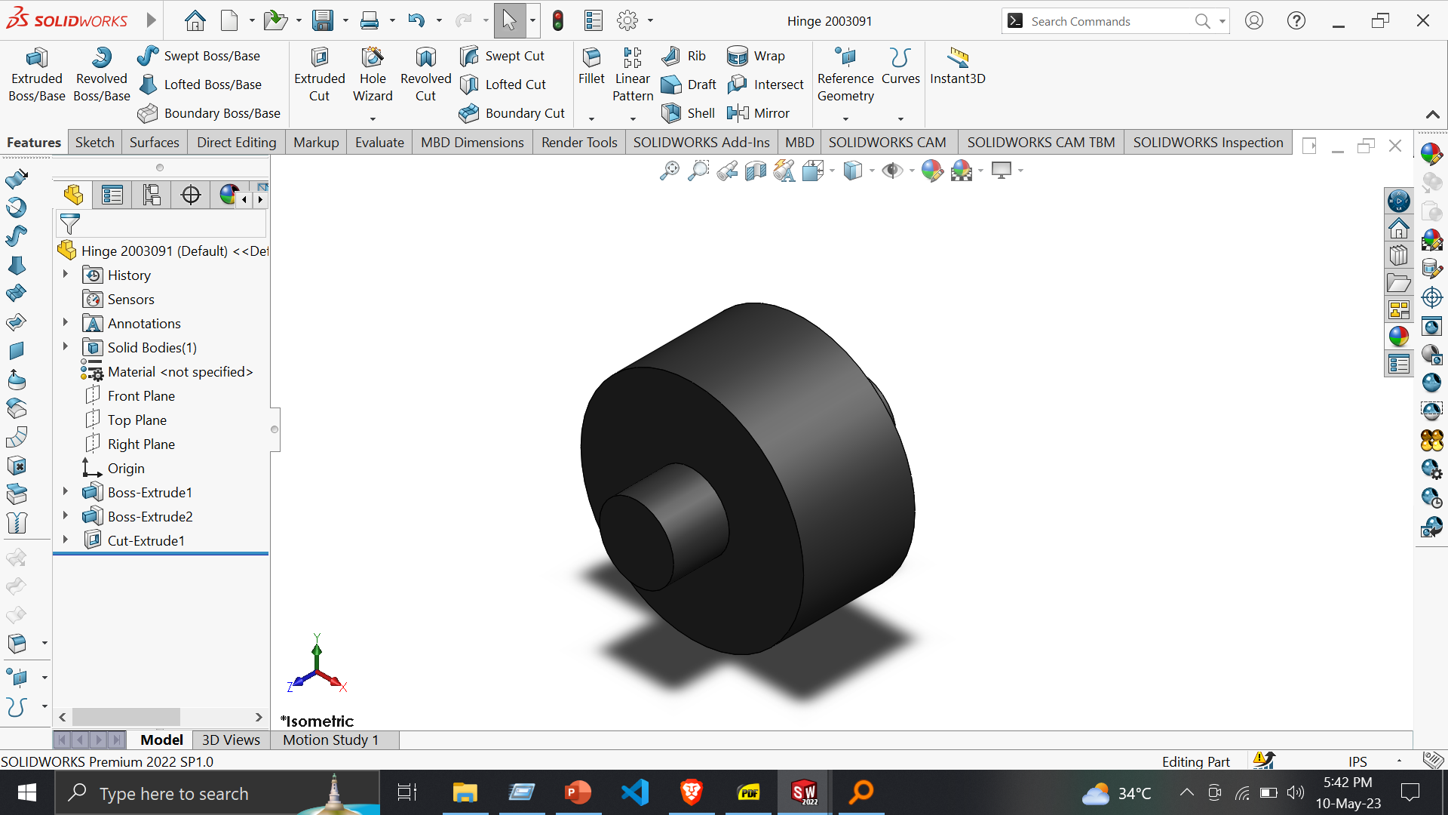
Shaft Assembly
Part 1 - Hinge
Tools :
Sketch
Smart Dimension
Features :
1. Extuded Boss/Base
2. Extruded Cut

Slide 3
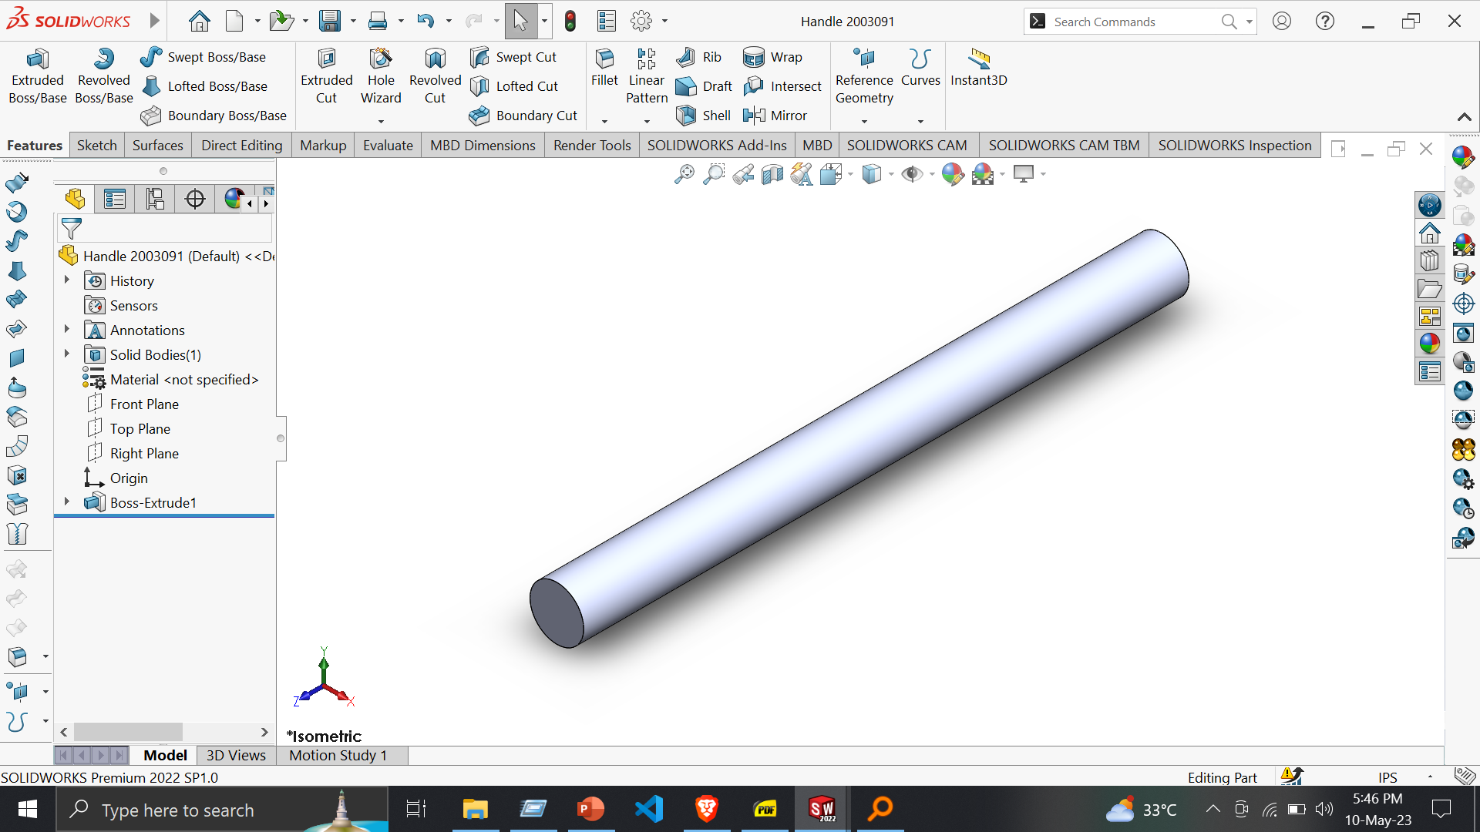
Part 2: Handle
Tools :
Sketch -> Circle
Smart Dimension
Features :
1. Extuded Boss/Base

Slide 4
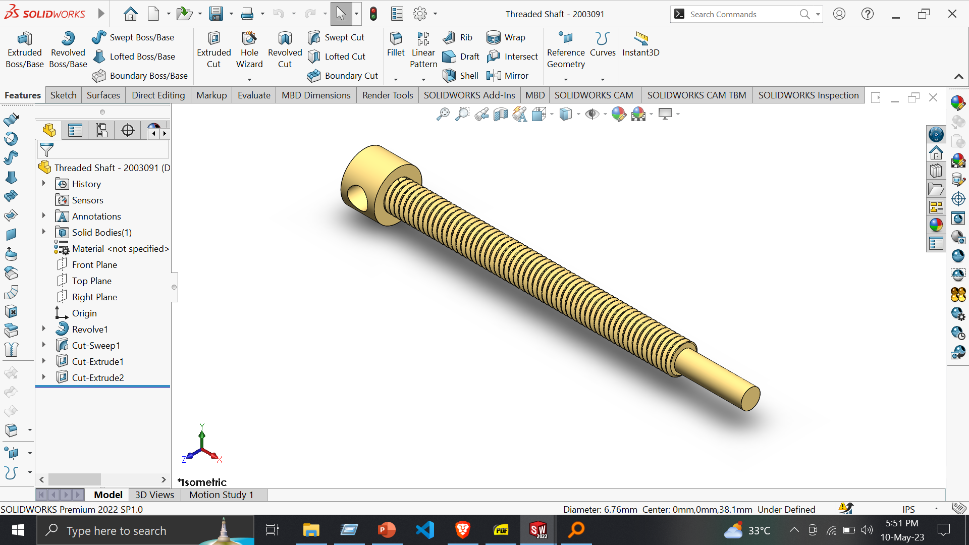
Part 3: Threaded Shaft
Tools :
Line
Centerline
Circle
Covert Entities
Smart Dimension
Features :
Extruded Boss/Base
Revolved Boss/Base
Swept Cut
Extruded Cut

Slide 5
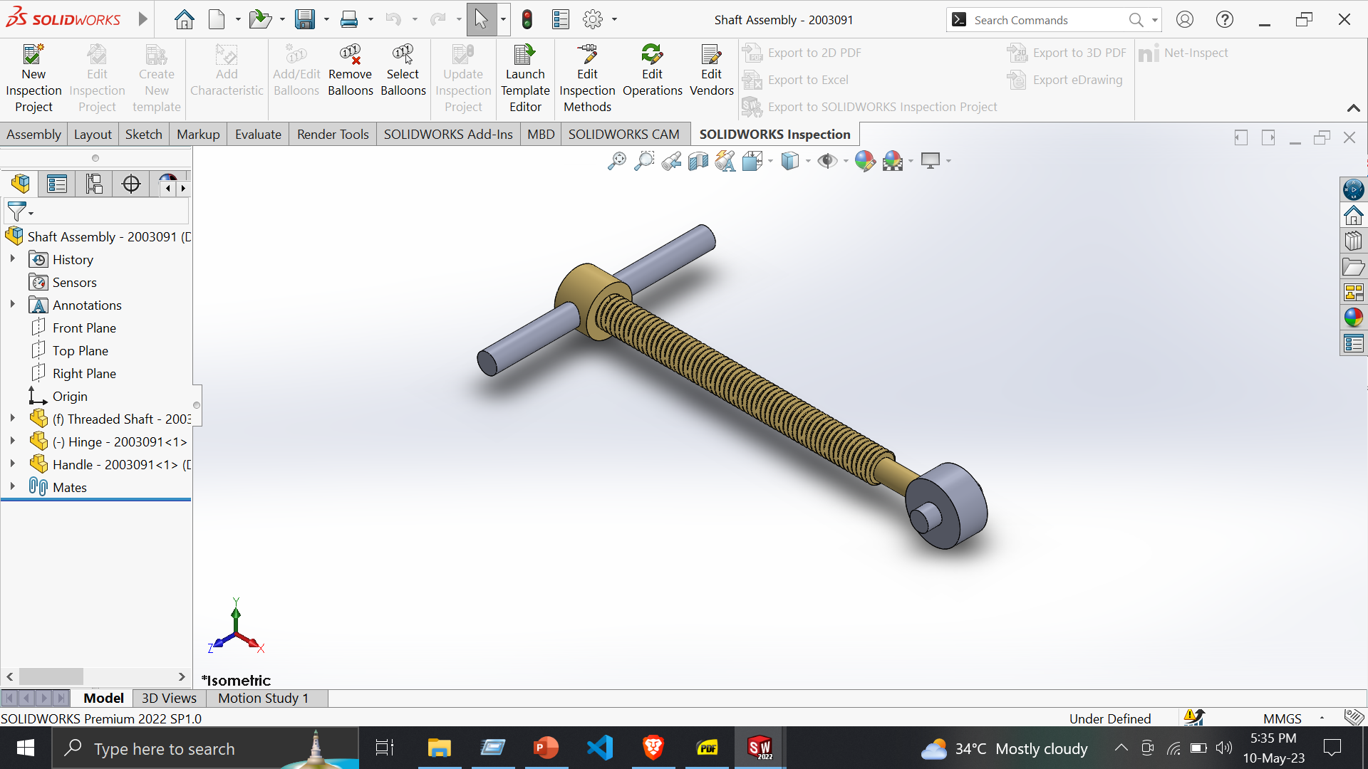
Shaft Assembly
Assembly –
Insert Component
Mate
-> Coincide
-> Concentric

Slide 6
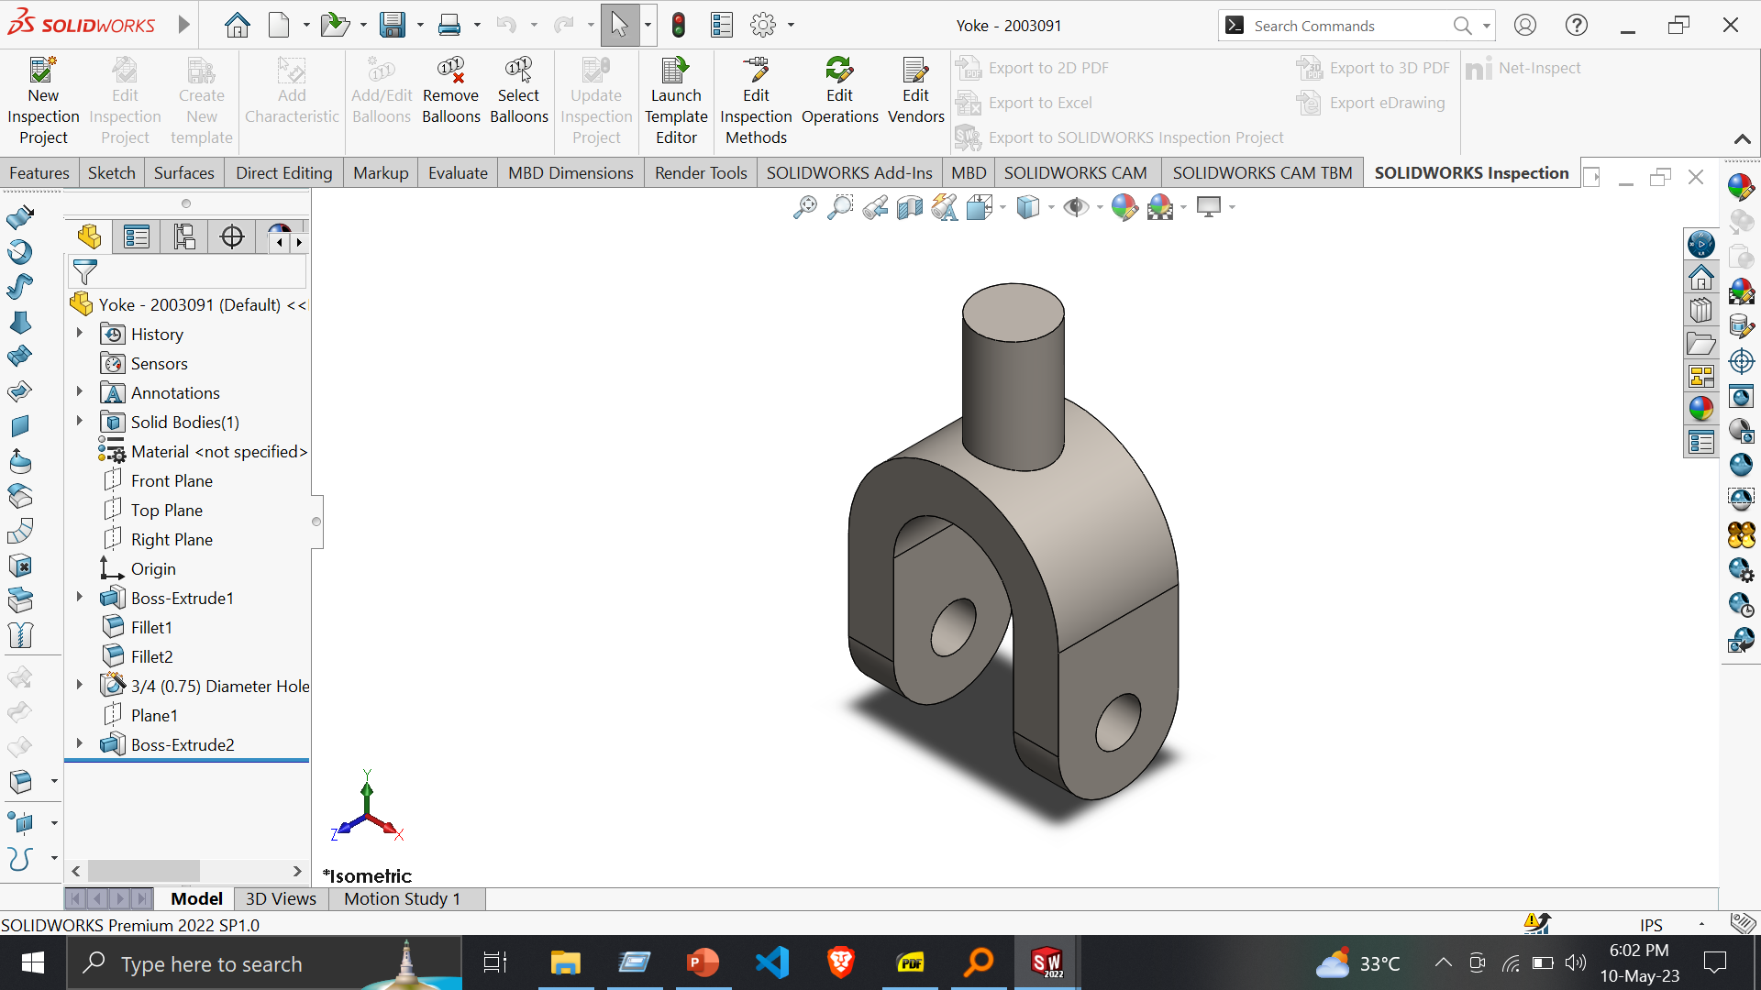
Universal Joint
Part 1: Yoke
Features:
Extruded Boss/Base
Fillet
Hole Wizard
Reference Geometry -> Plane
Tools:
Line
Centerline
Circle
Smart Dimension

Slide 7
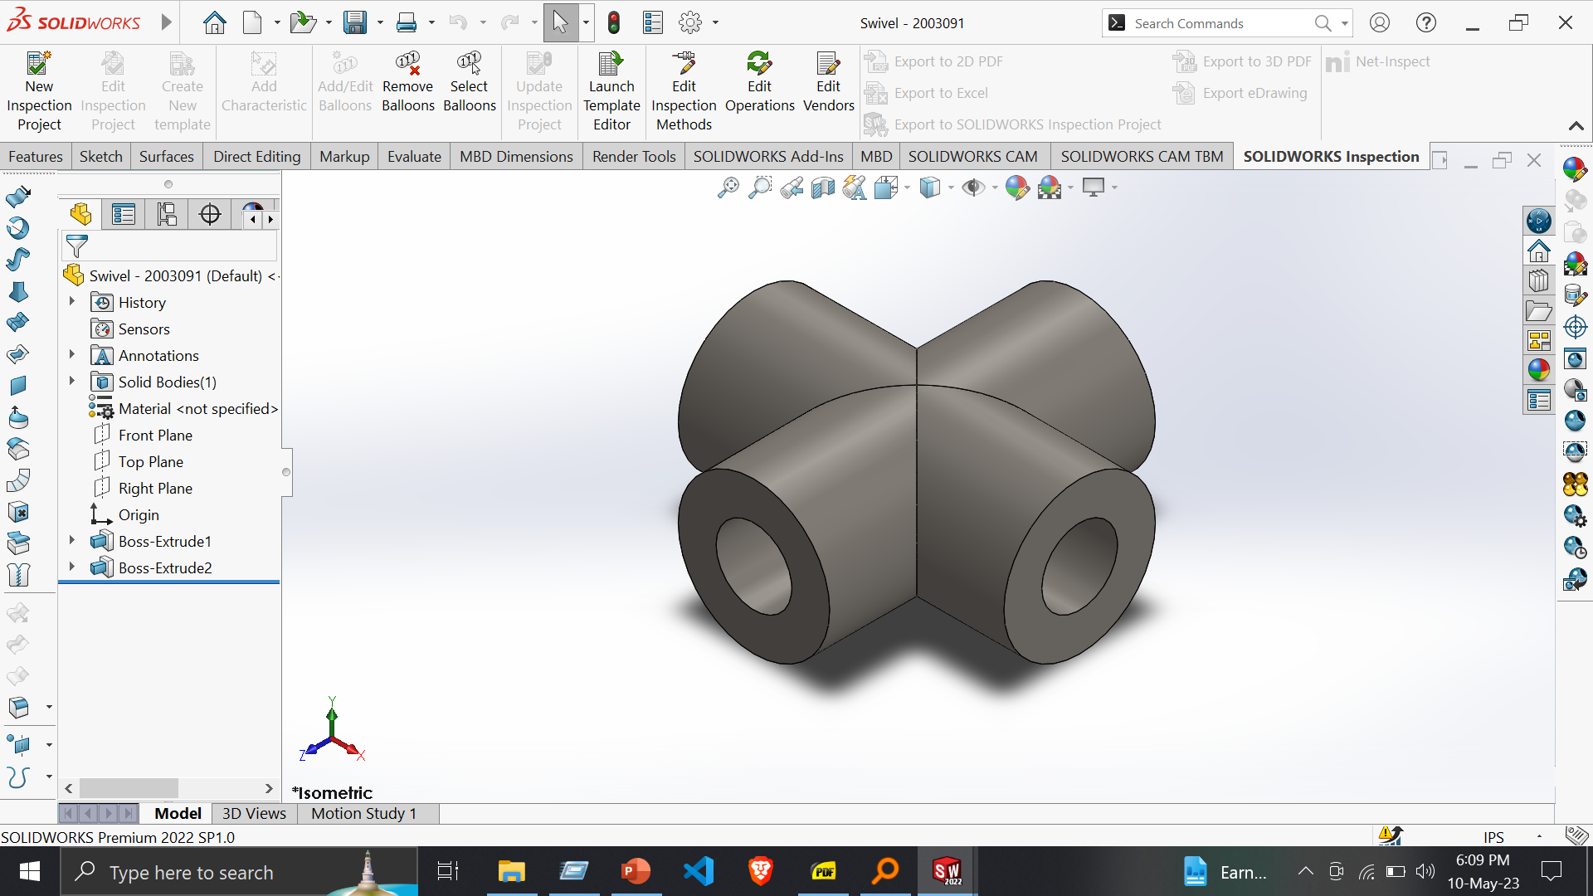
Part 2: Swivel
Features:
Extruded Boss/Base
Tools:
Sketch
Smart Dimension

Slide 8
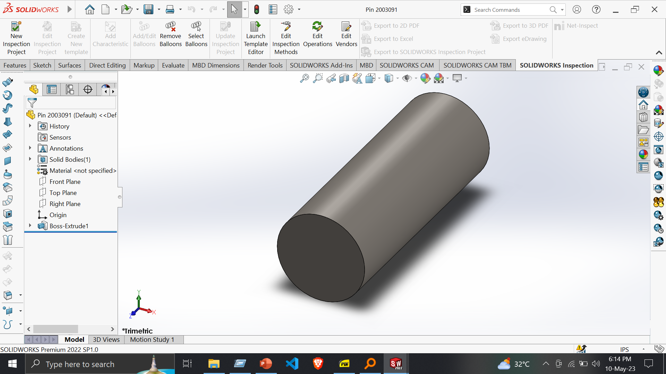
Part 3: Pin
Features:
Extruded Boss/Base
Tools:
Sketch
Smart Dimension

Slide 9
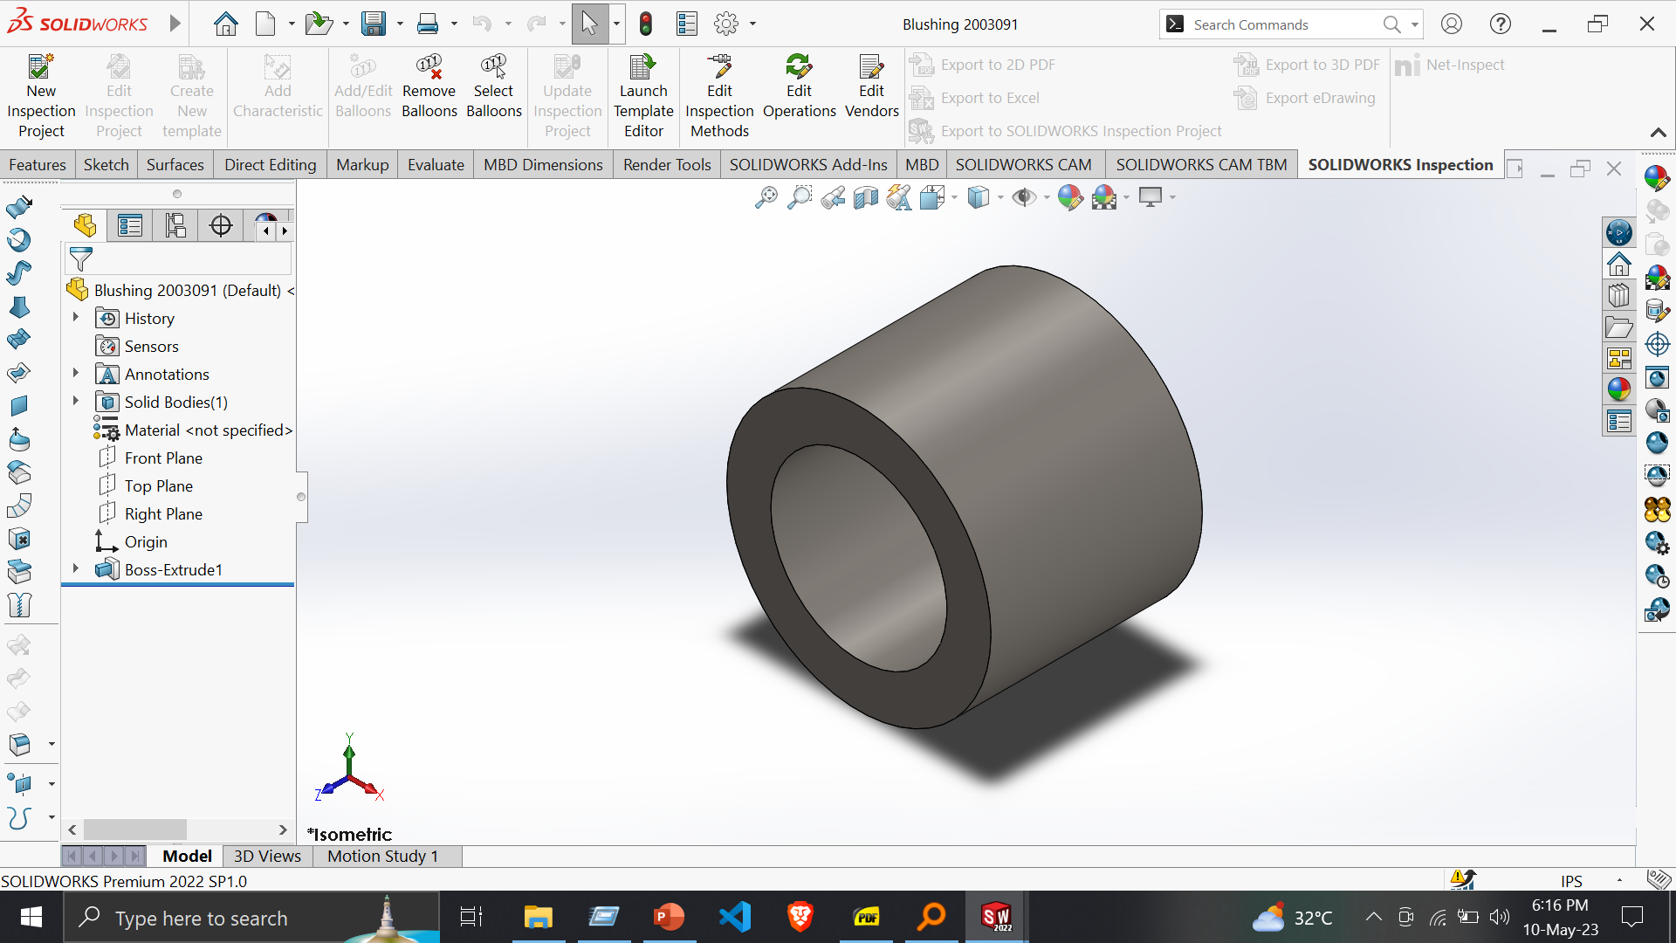
Part 4: Blushing
Features:
Extruded Boss/Base
Extruded Cut
Tools:
Sketch
Smart Dimension

Slide 10
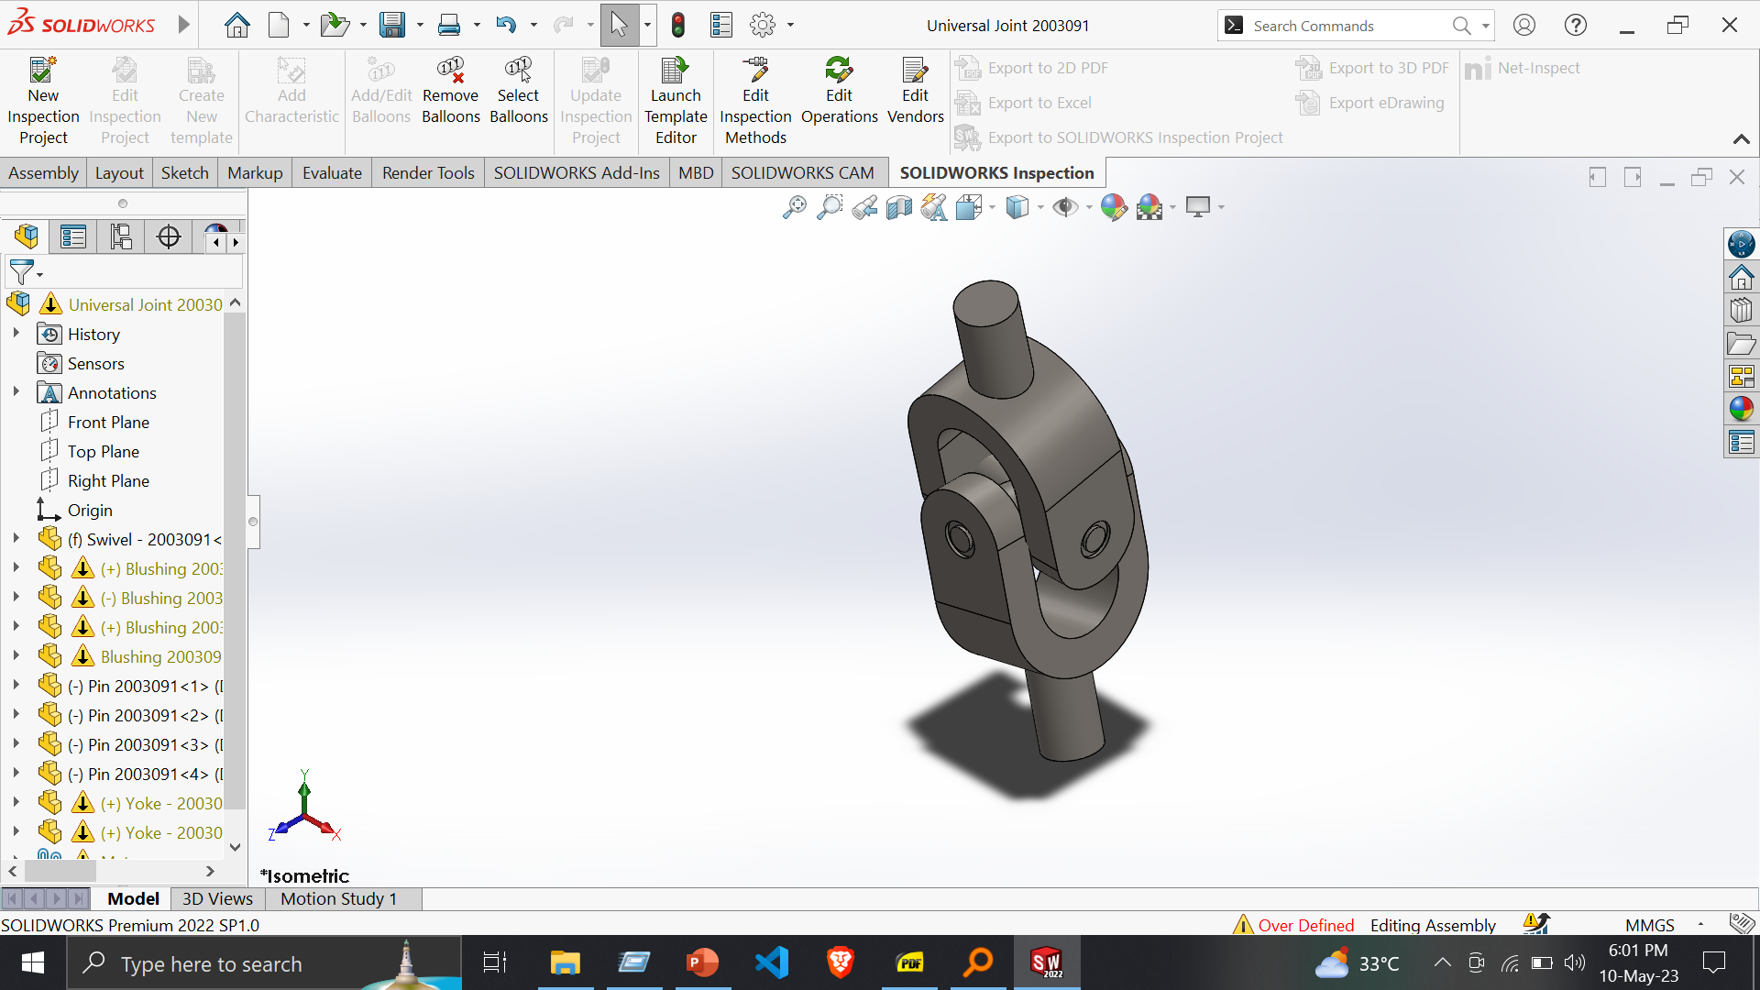
Universal Joint
Assembly –
Insert Component
Mate
Coincide
Concentric
Advanced Mate - Width

Slide 11
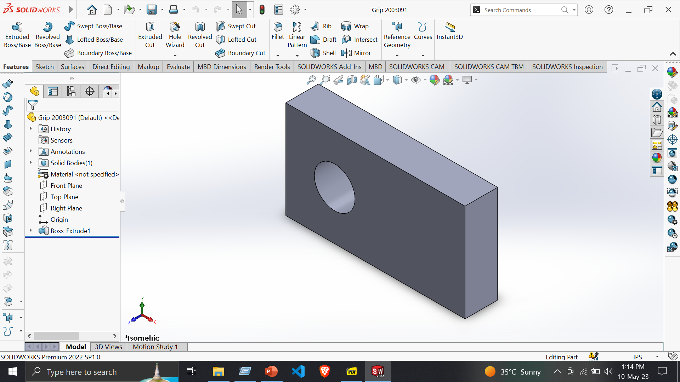
Clamp
Part 1: Grip
Features:
Extruded Boss/Base
Extruded Cut
Tools:
Sketch
Smart Dimension

Slide 12
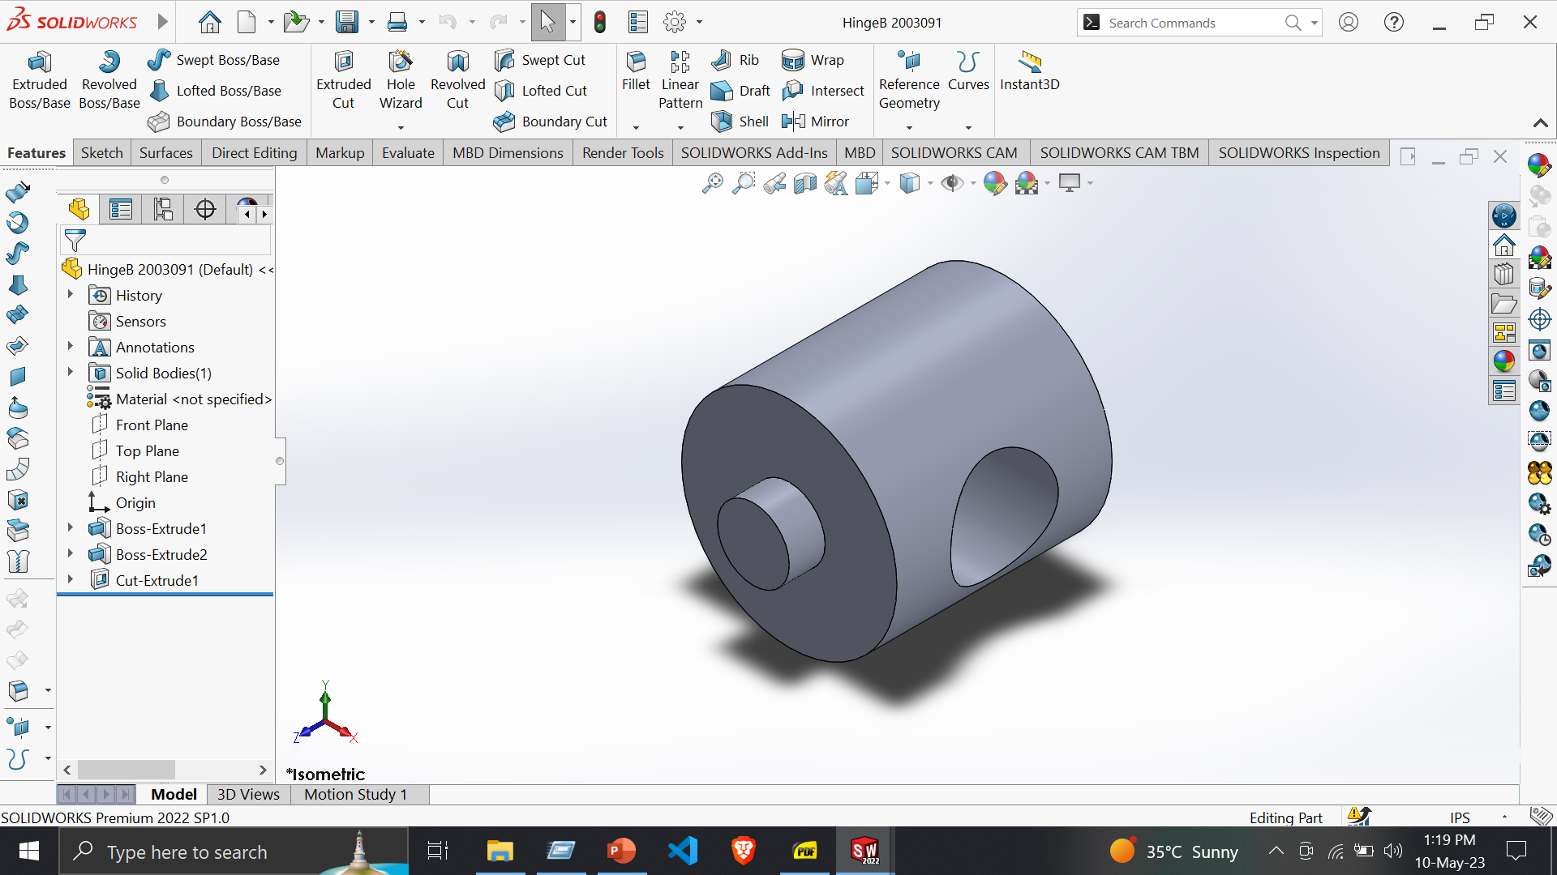
Part 2: Hinge B
Features:
Extruded Boss/Base
Extruded Cut
Tools:
Sketch
Smart Dimension

Slide 13
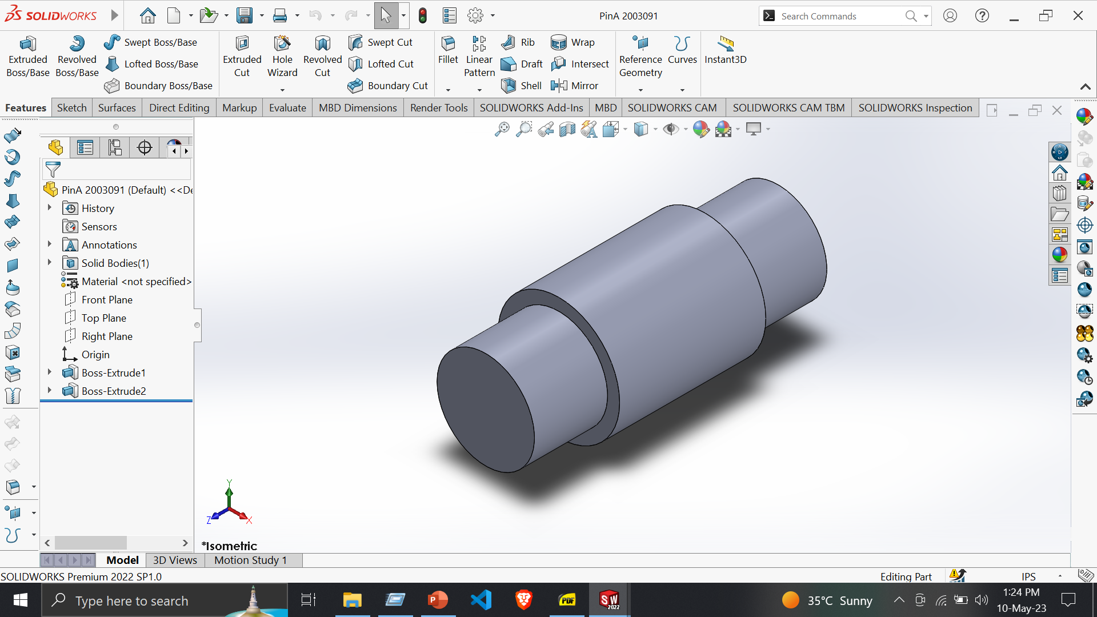
Part 3: Pin A
Features:
Extruded Boss/Base
Extruded Cut
Tools:
Sketch
Smart Dimension

Slide 14
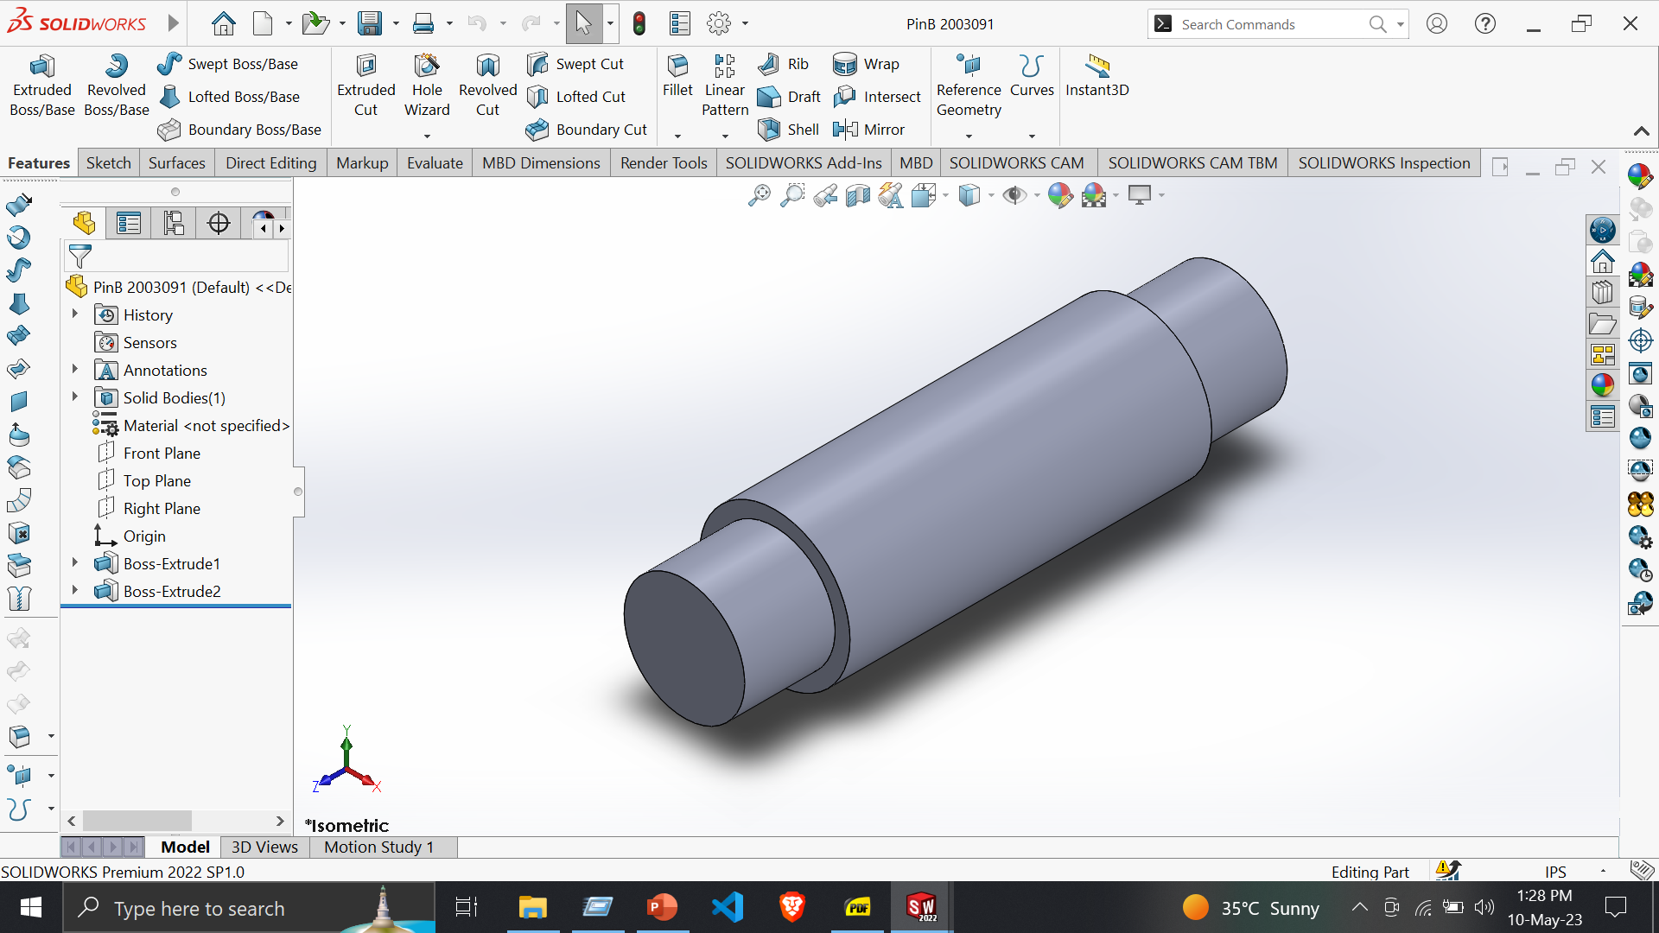
Part 4: Pin B
Features:
Extruded Boss/Base
Tools:
Sketch
Smart Dimension

Slide 15
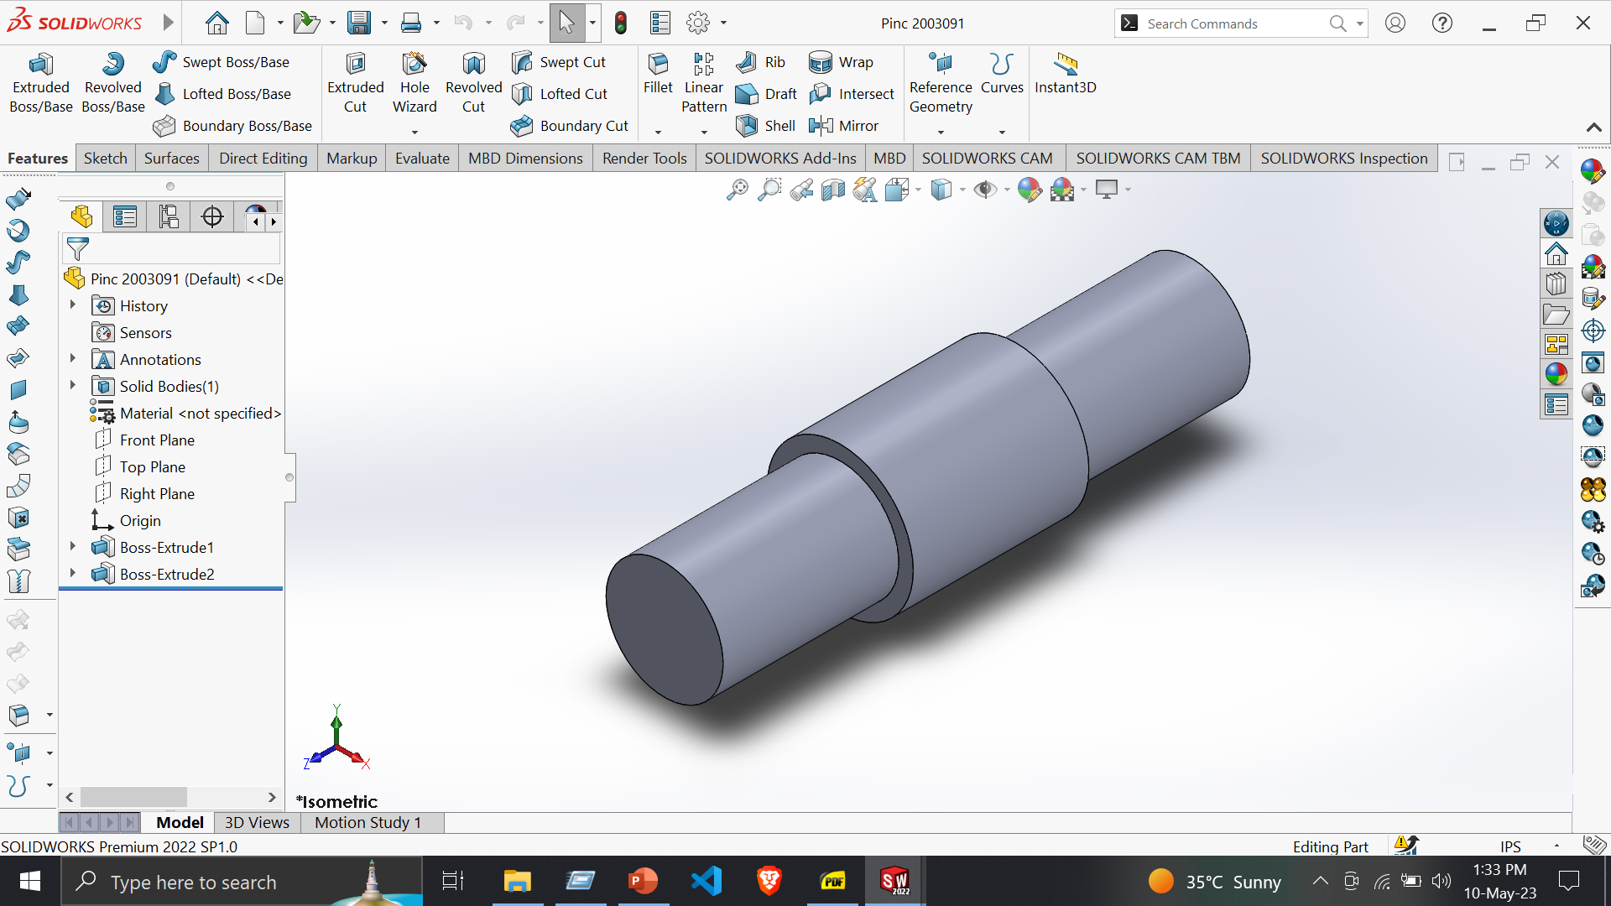
Part 5: Pin C
Features:
Extruded Boss/Base
Tools:
Sketch
Smart Dimension

Slide 16
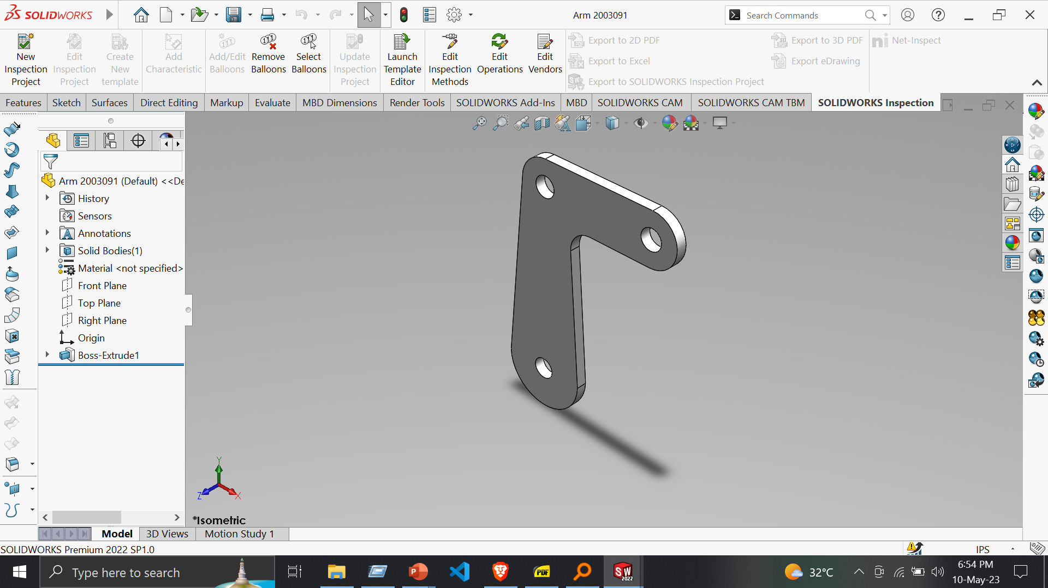
Part 6 : Arm
Features:
Extruded Boss/Base
Extruded Cut
Tools:
Sketch
Smart Dimension
Fillet
Add Relation

Slide 17
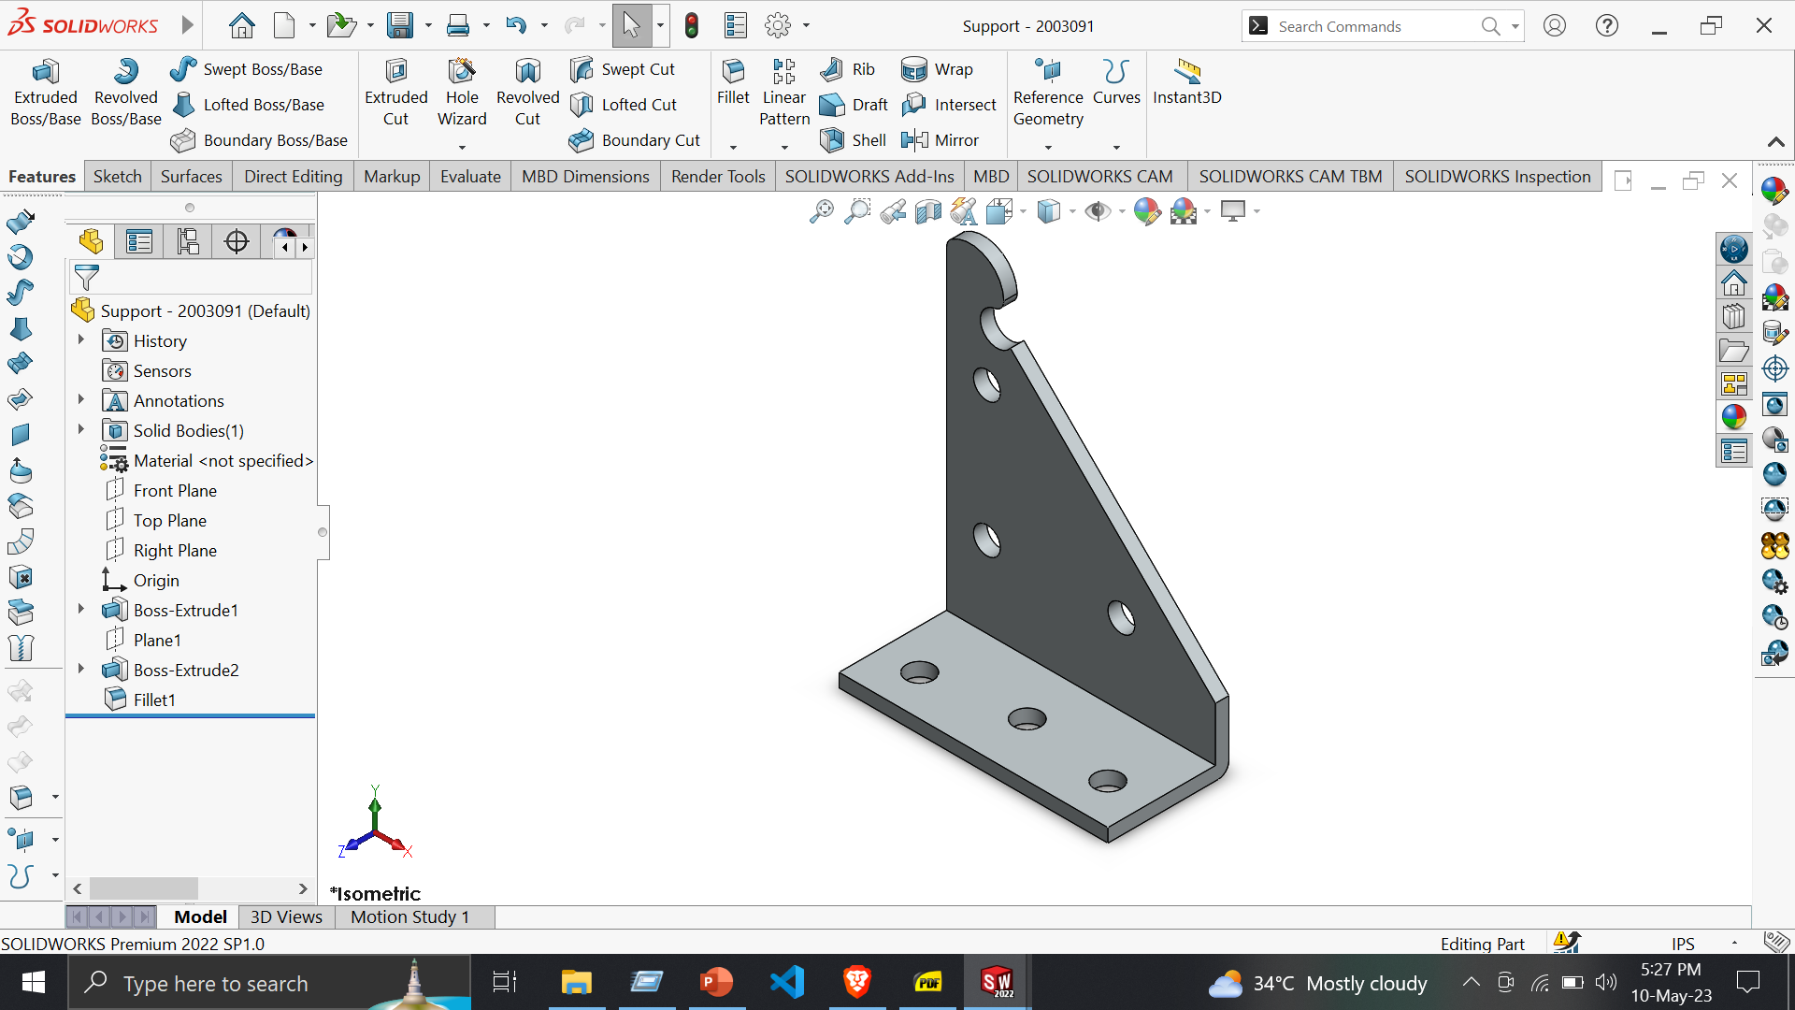
Part 7: Support
Features:
Extruded Boss/Base
Reference Geometry -> Plane
Fillet
Tools:
Line
Circle
Sketch Fillet
Trim Entities
5. Display/Delete Relations -> Add Relation
6. Smart Dimension

Slide 18
Part 8: Shaft Assembly

Slide 19
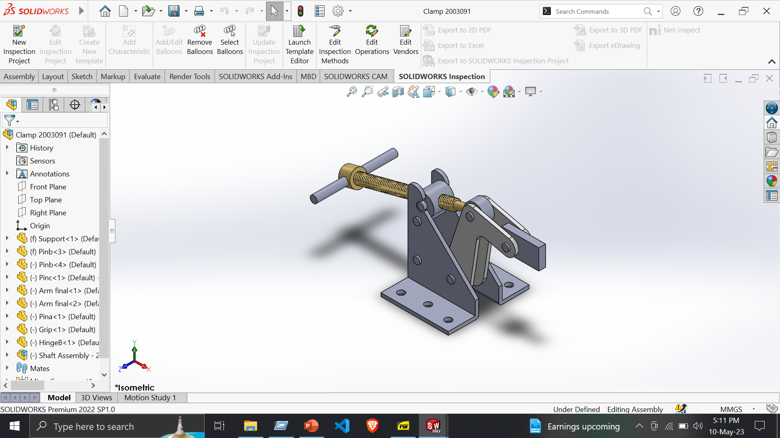
Clamp
Assembly-
Insert Component
Mate
Mirror
Unfix
Coincide
Concentric
Width

Slide 20
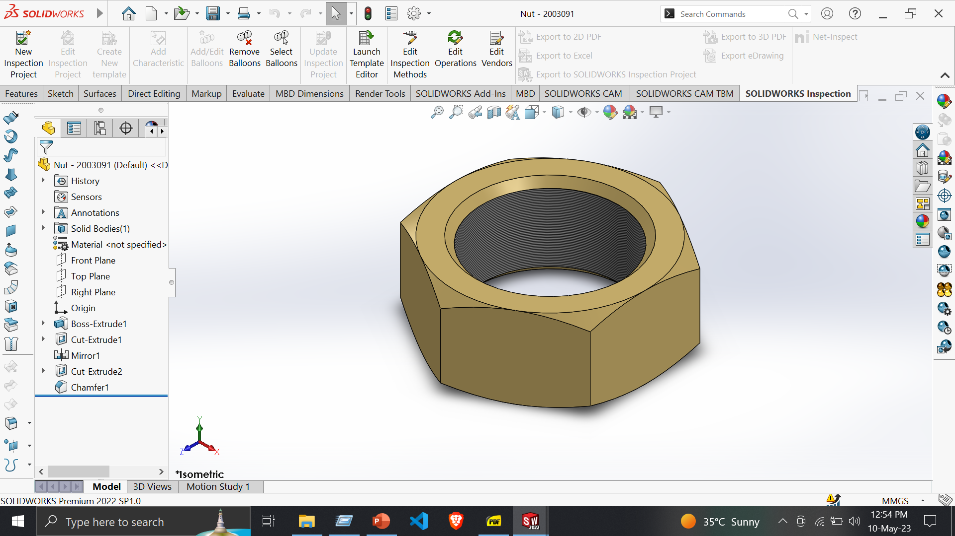
Flange Coupling
Part 1 - Nut
Features:
Extruded Boss/Base
Extruded Cut
Tools:
Line
Circle
Sketch Fillet
Smart Dimension
Chamfer

Slide 21
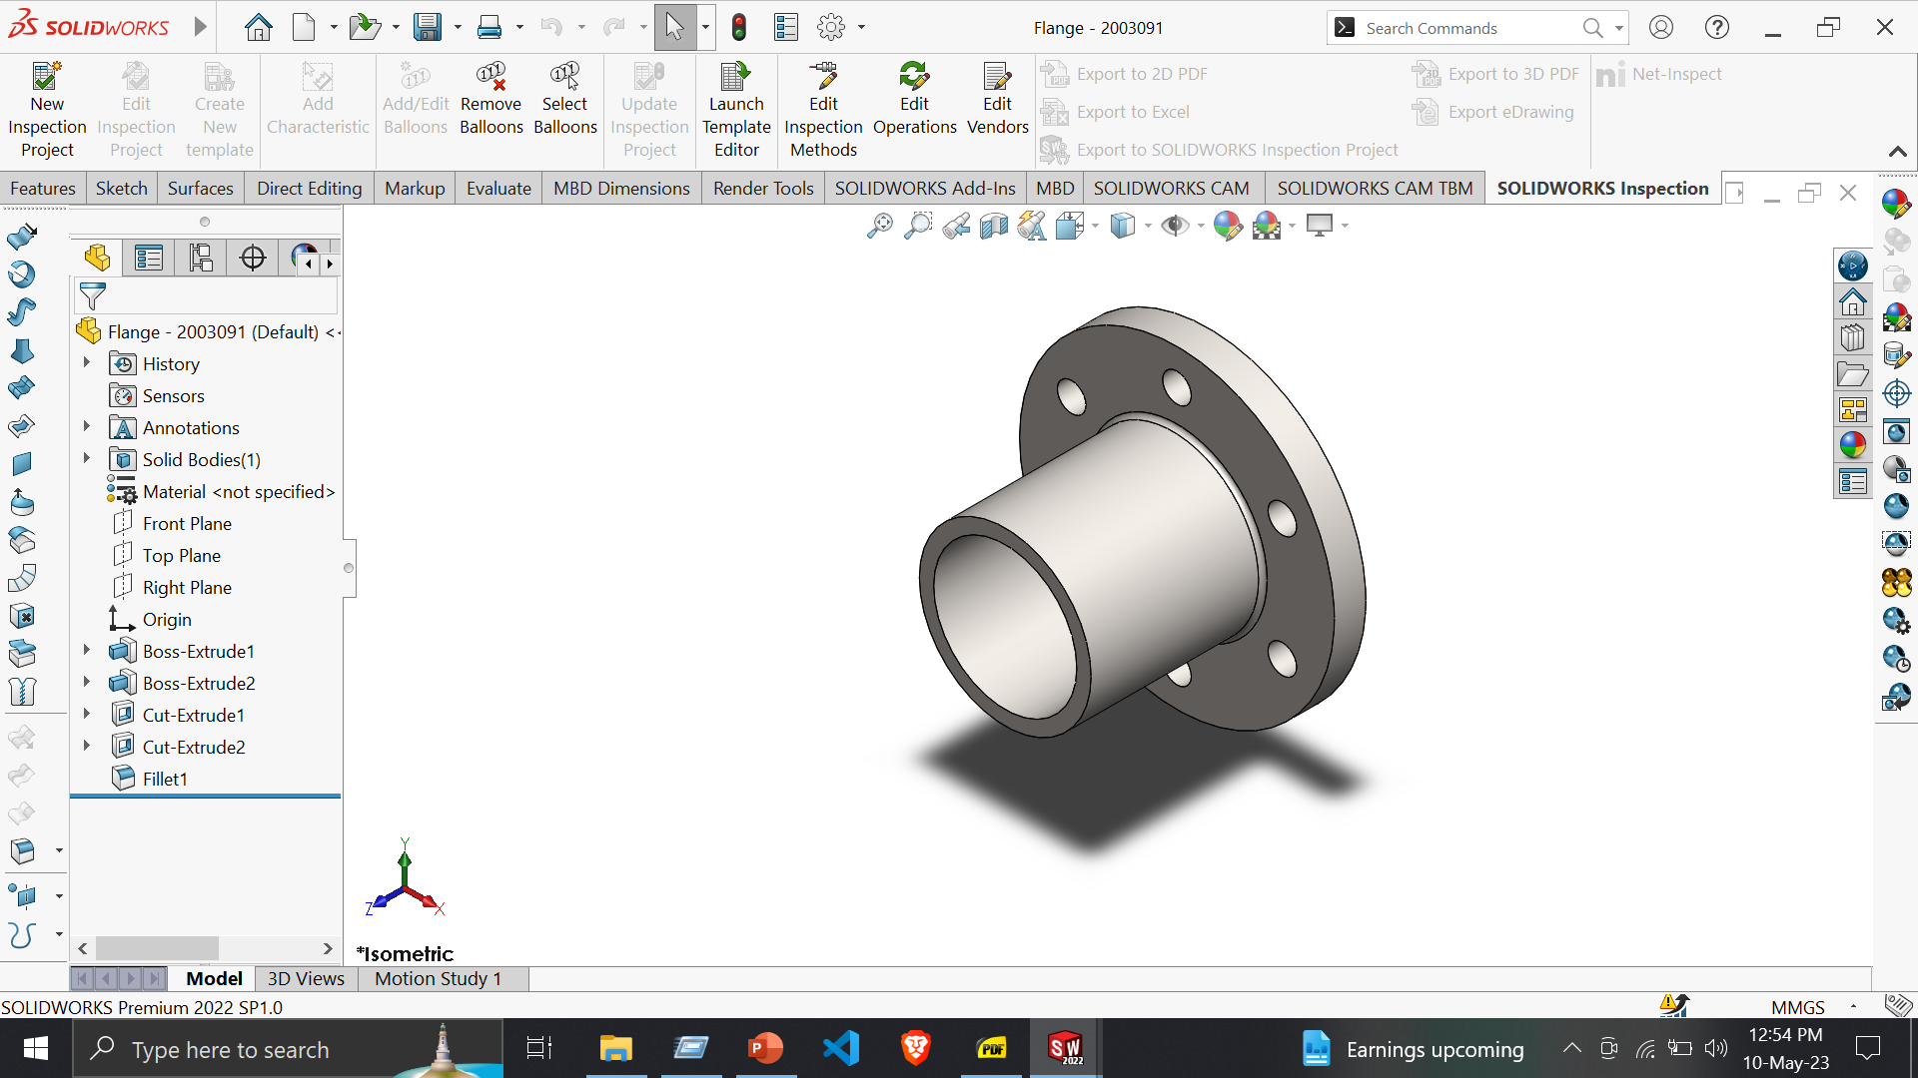
Part 2: Flange
Features:
Extruded Boss/Base
Extruded Cut
Tools:
Line
Circle
Smart Dimension
Circular pattern

Slide 22
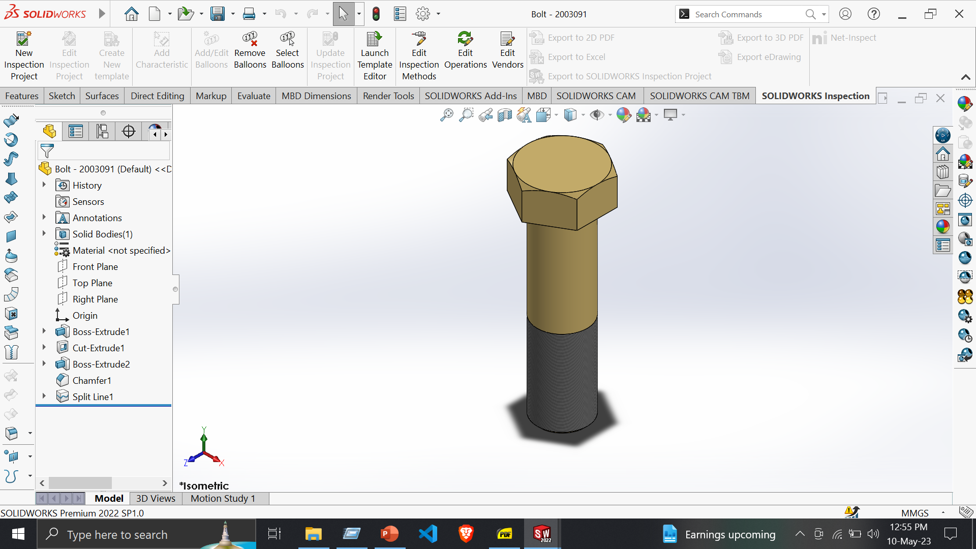
Part 3: Bolt
Features:
Extruded Boss/Base
Tools:
Line
Circle
Smart Dimension

Slide 23
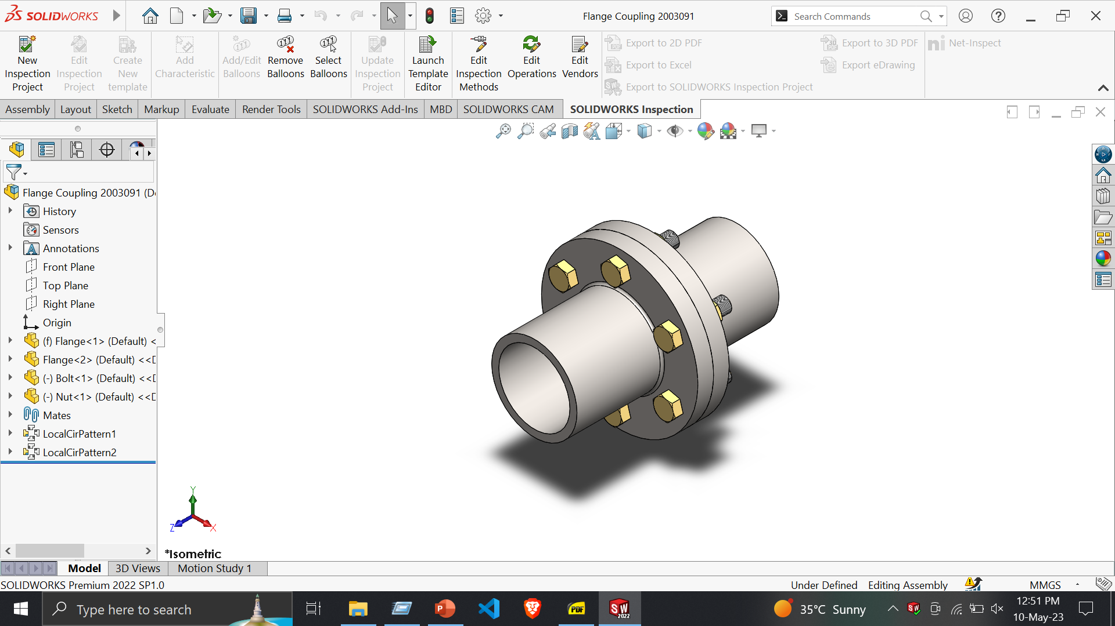
Flange Coupling
Assembly –
Insert Component
Mate
Concentric
Coincide
Width
Circular Pattern

Slide 24
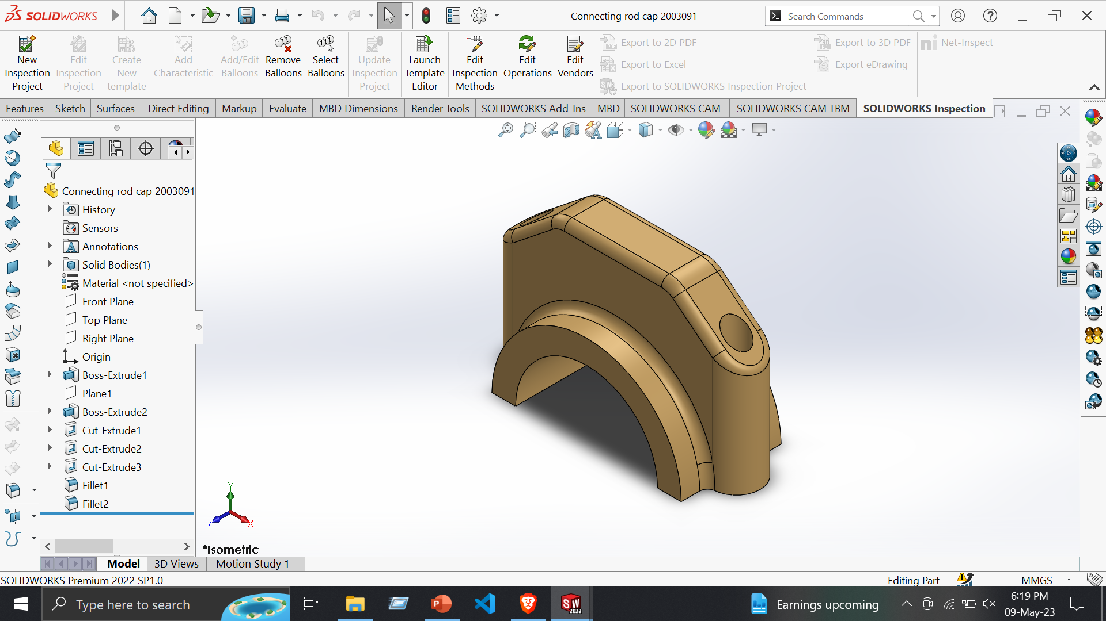
Four Cylinder Engine
Part 1: Connecting rod Cap
Features:
Extruded Boss/Base
Extruded Cut
Fillet
Tools:
Line
Circle
Smart Dimension
Circular pattern
Trim Entities
Convert Entities

Slide 25
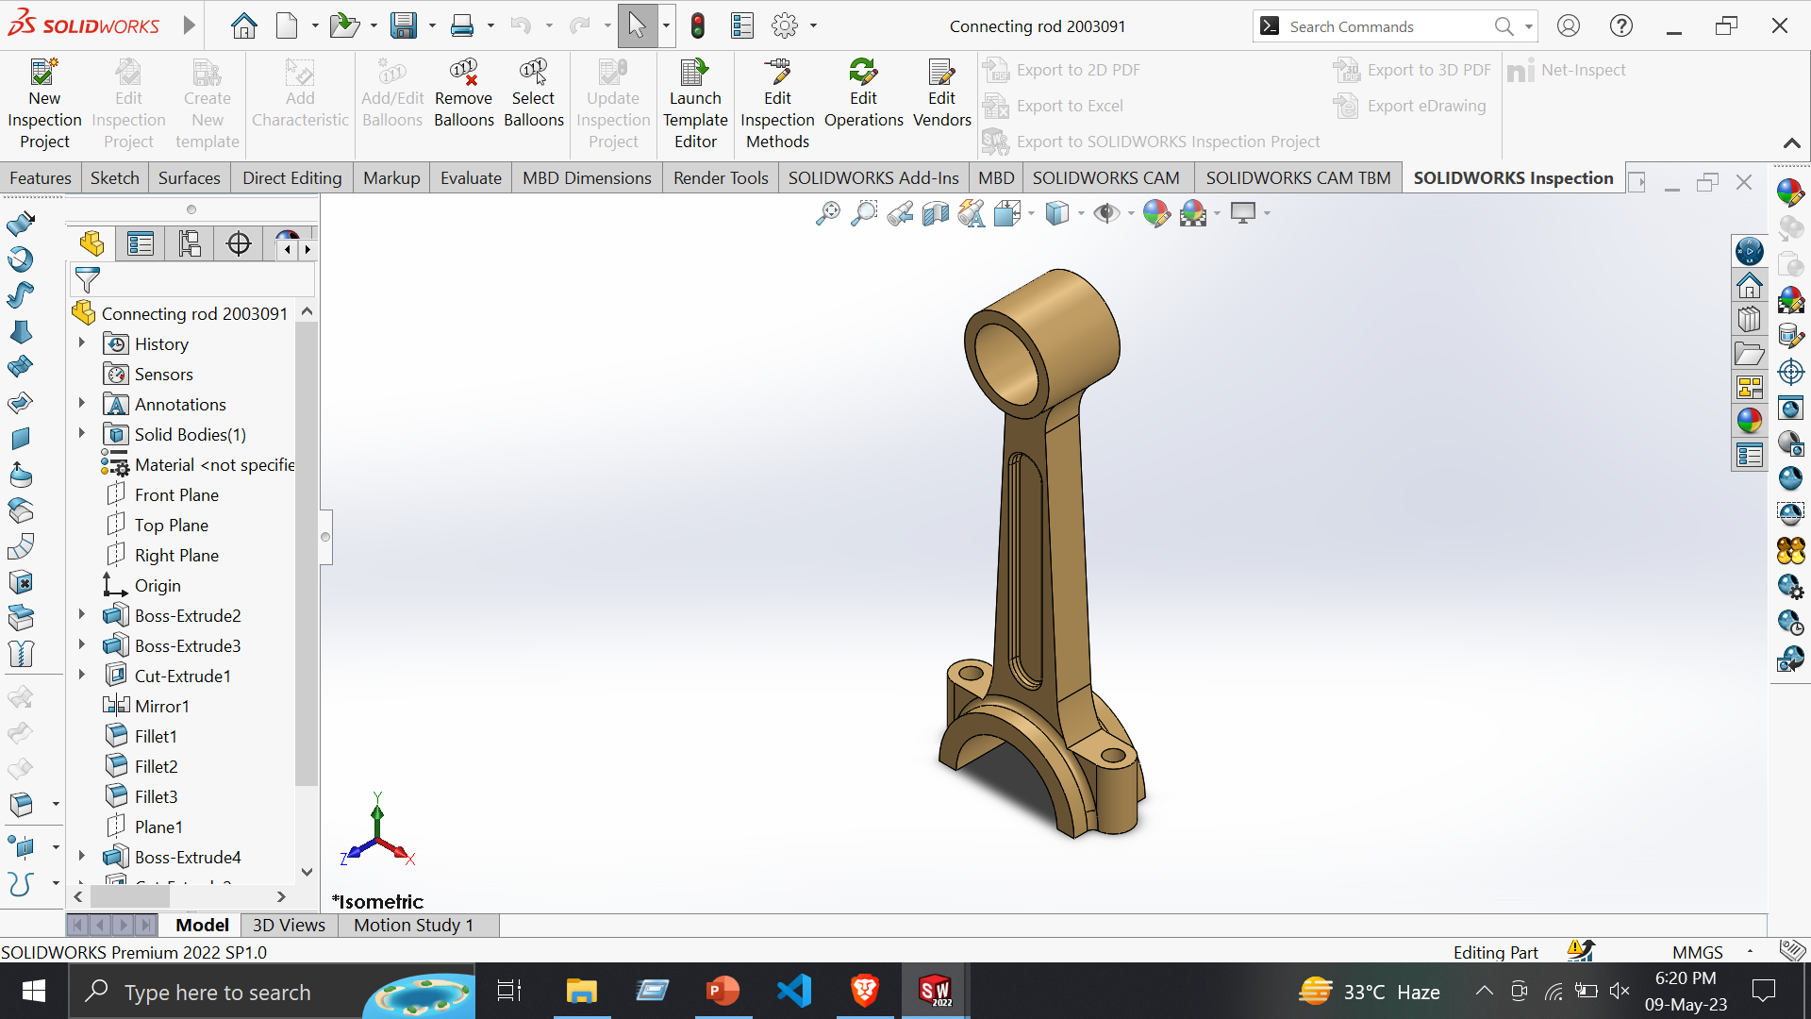
Part 2: Connecting Rod
Features:
Extruded Boss/Base
Extruded Cut
Fillet
Tools:
Line
Circle
Smart Dimension
Circular pattern
Trim Entities
Convert Entities

Slide 26
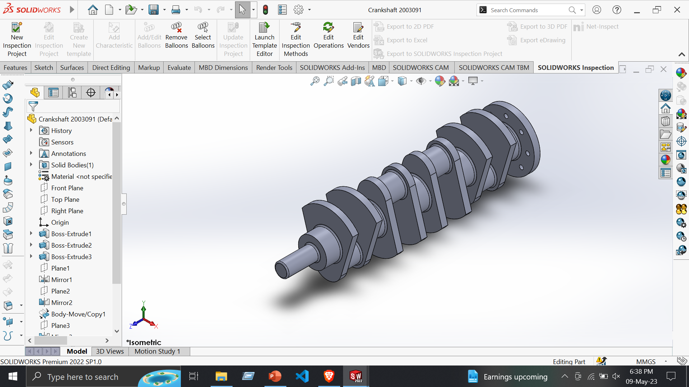
Part 3: Crankshaft
Features:
Extruded Boss/Base
Extruded Cut
Fillet
Tools:
Line
Circle
Smart Dimension
Circular pattern
Trim Entities
Convert Entities

Slide 27
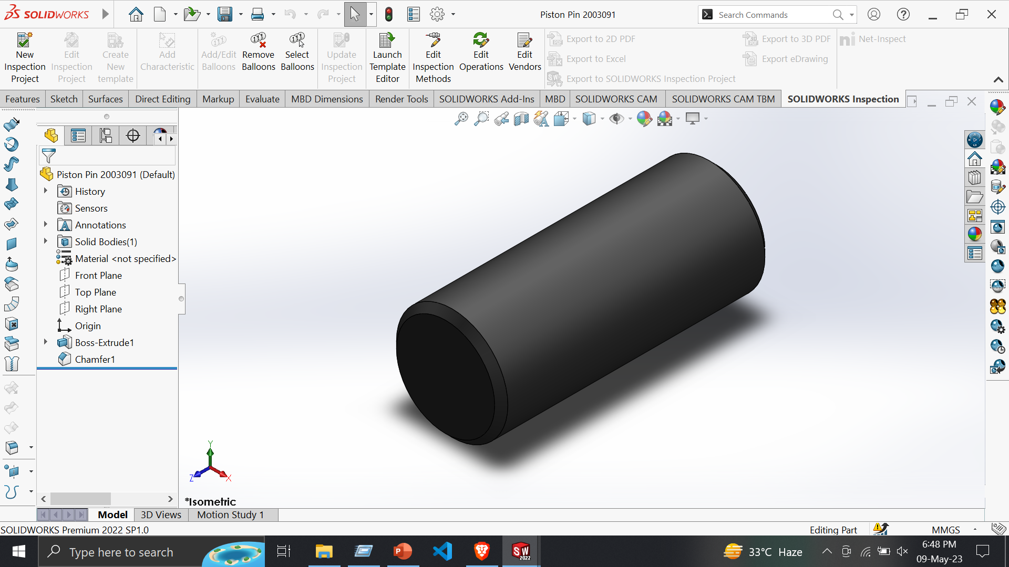
Part 4: Piston Pin
Features:
Extruded Boss/Base
Tools:
Line
Circle
Smart Dimension

Slide 28
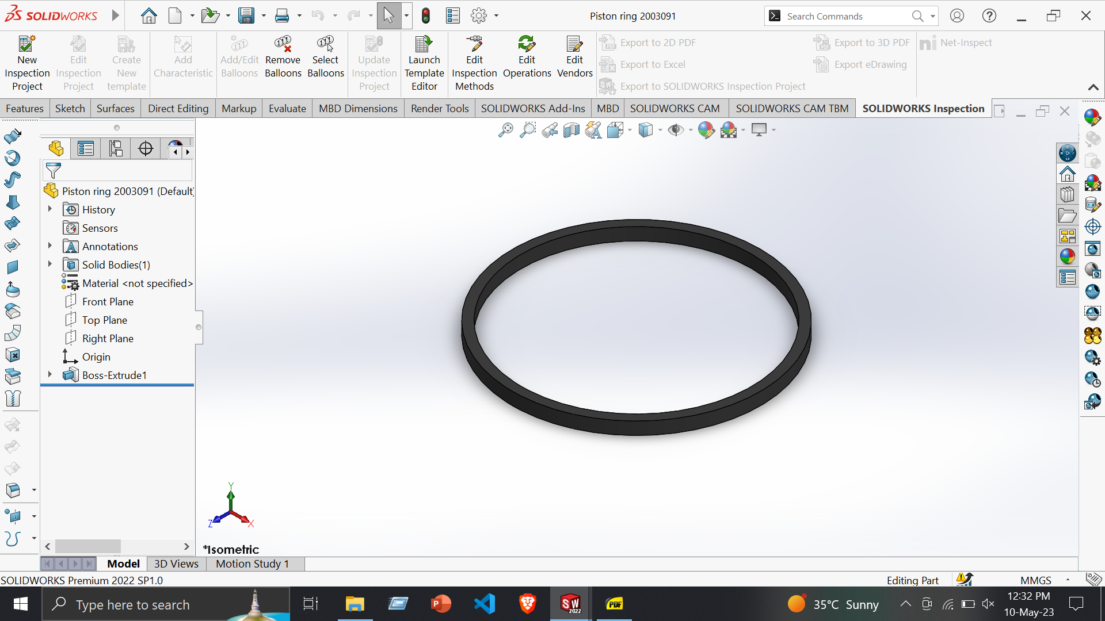
Part 5: Piston Ring
Features:
Extruded Boss/Base
Tools:
Circle
Smart Dimension

Slide 29
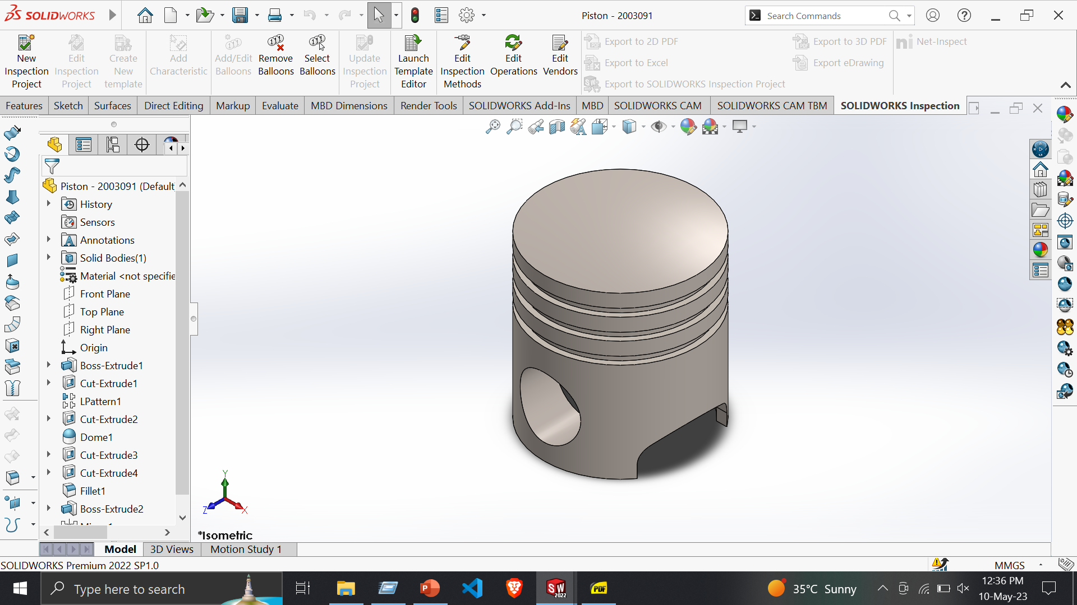
Part 6: Piston
Features:
Extruded Boss/Base
Extruded Cut
Tools:
Line
Circle
Smart Dimension
Trim Entities

Slide 30
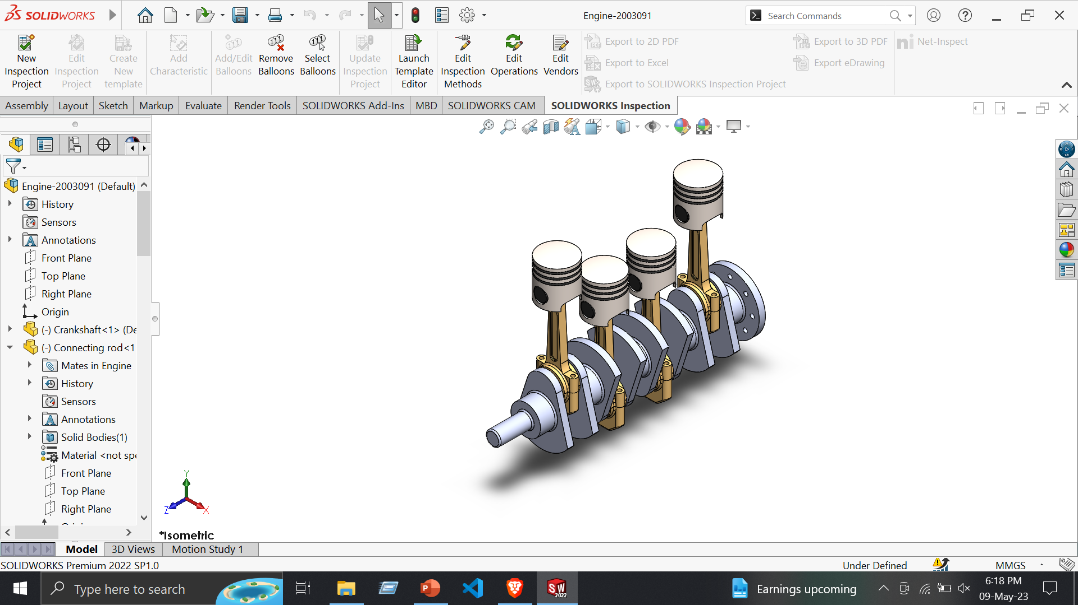
Four cylinder Engine
Assembly –
Insert Component
Sketch
Width
Circular pattern
Mirror
Coincide
Concentric

Slide 31
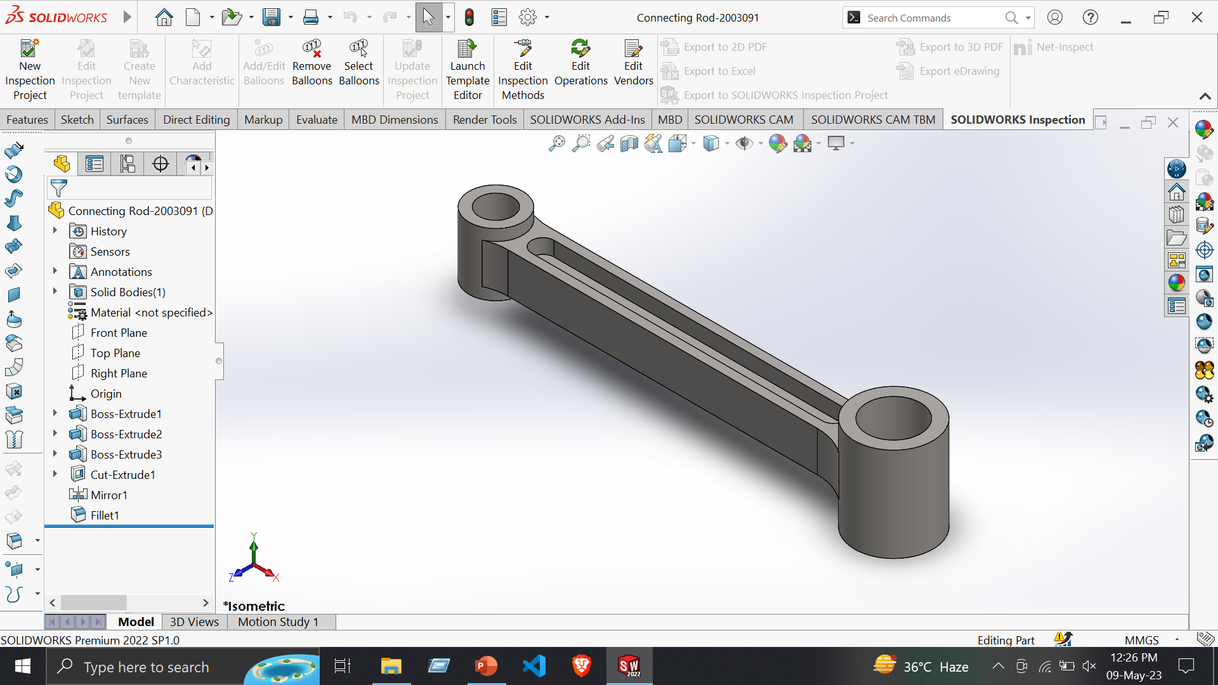
Radial Engine
Part 1: Connecting Rod
Features:
Extruded Boss/Base
Extruded Cut
Tools:
Line
Circle
Three point Arc
Smart Dimension
Trim Entities

Slide 32
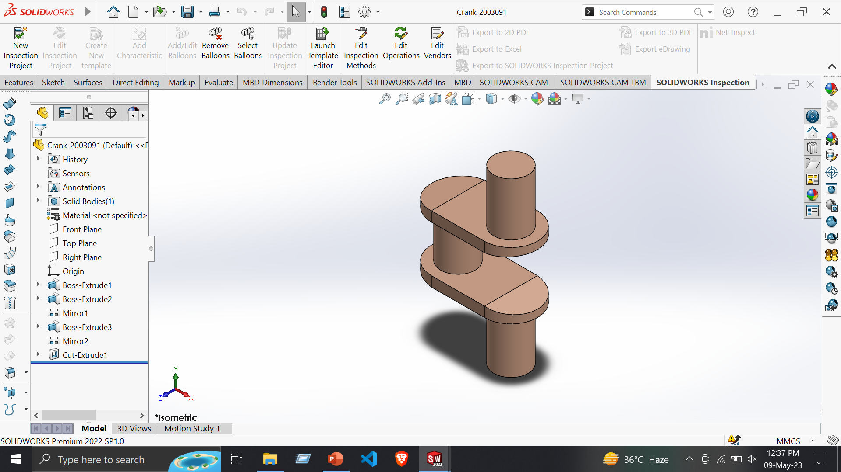
Part 2: Crank
Features:
Extruded Boss/Base
Extruded Cut
Tools:
Line
Circle
Smart Dimension

Slide 33
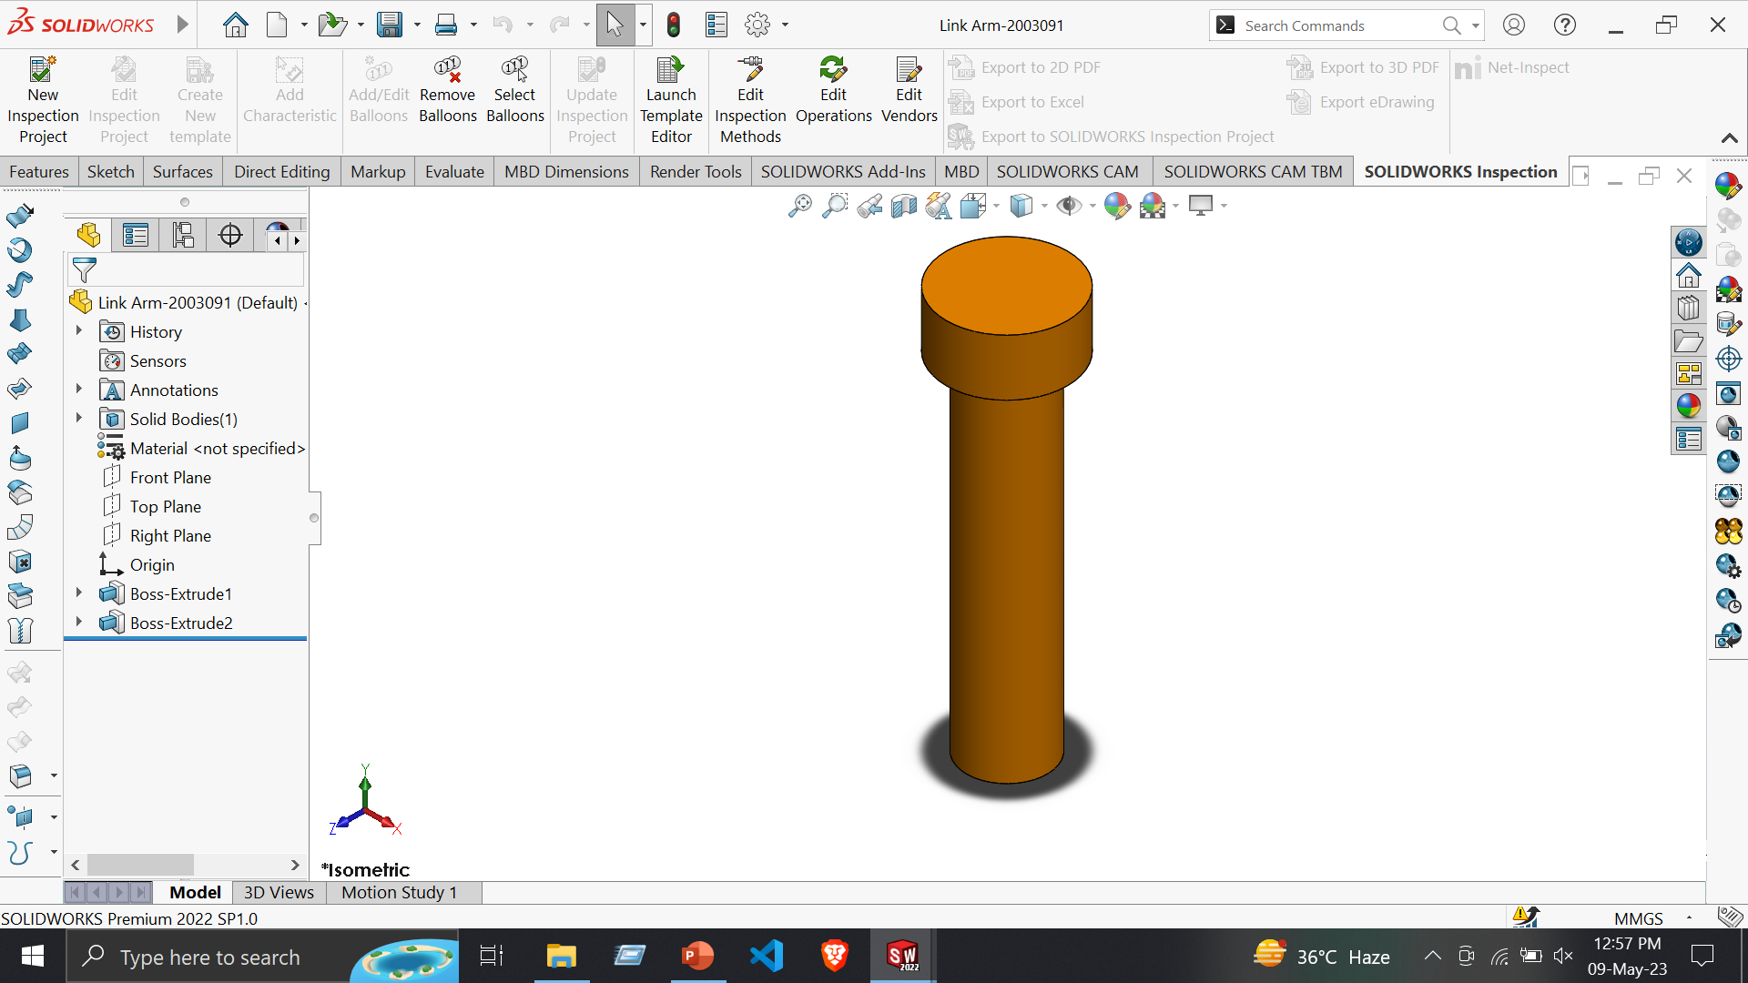
Part 3: Link Arm
Features:
Extruded Boss/Base
Tools:
Line
Circle
Smart Dimension

Slide 34
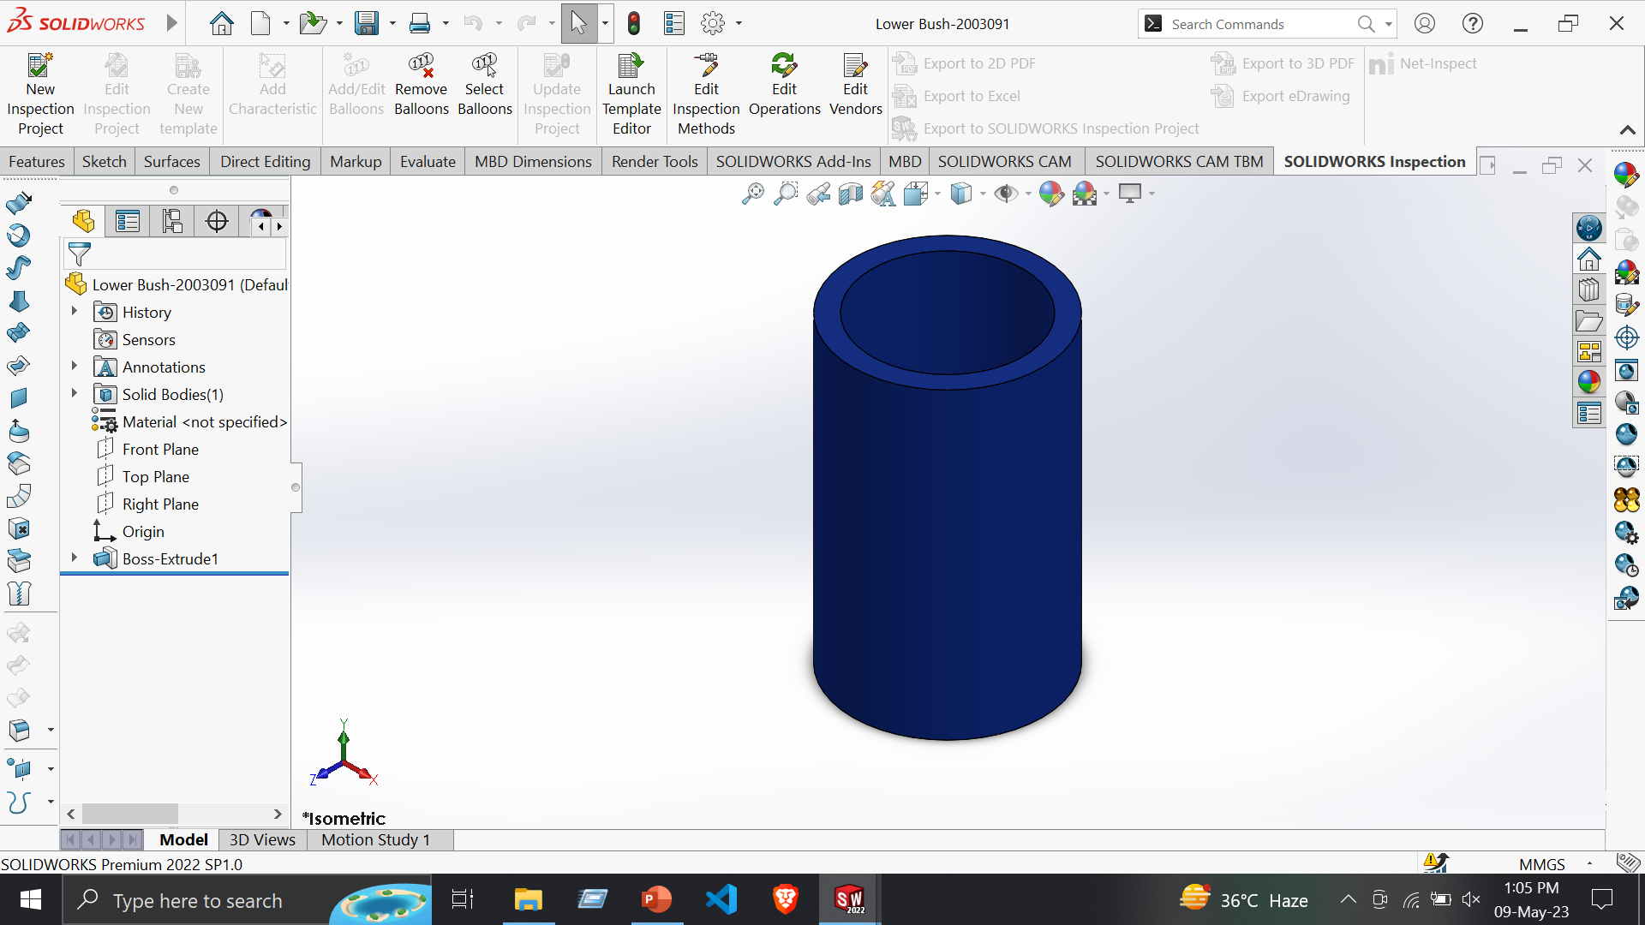
Part 4: Lower Bush
Features:
Extruded Boss/Base
Extruded Cut
Tools:
Line
Circle
Smart Dimension

Slide 35
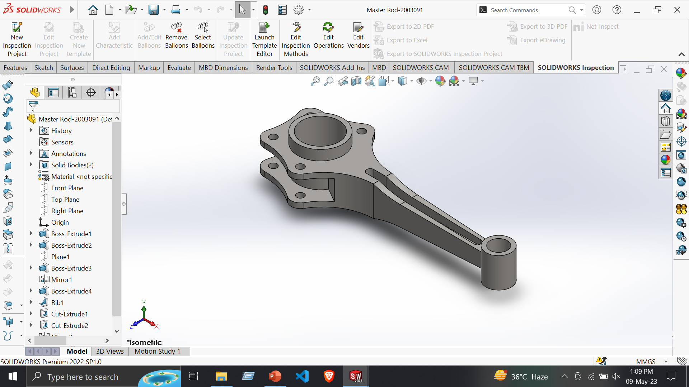
Part 5: Master rod
Features:
Extruded Boss/Base
Extruded Cut
Fillet
Tools:
Line
Centerline
Circle
Construction Geometry
Smart Dimension

Slide 36
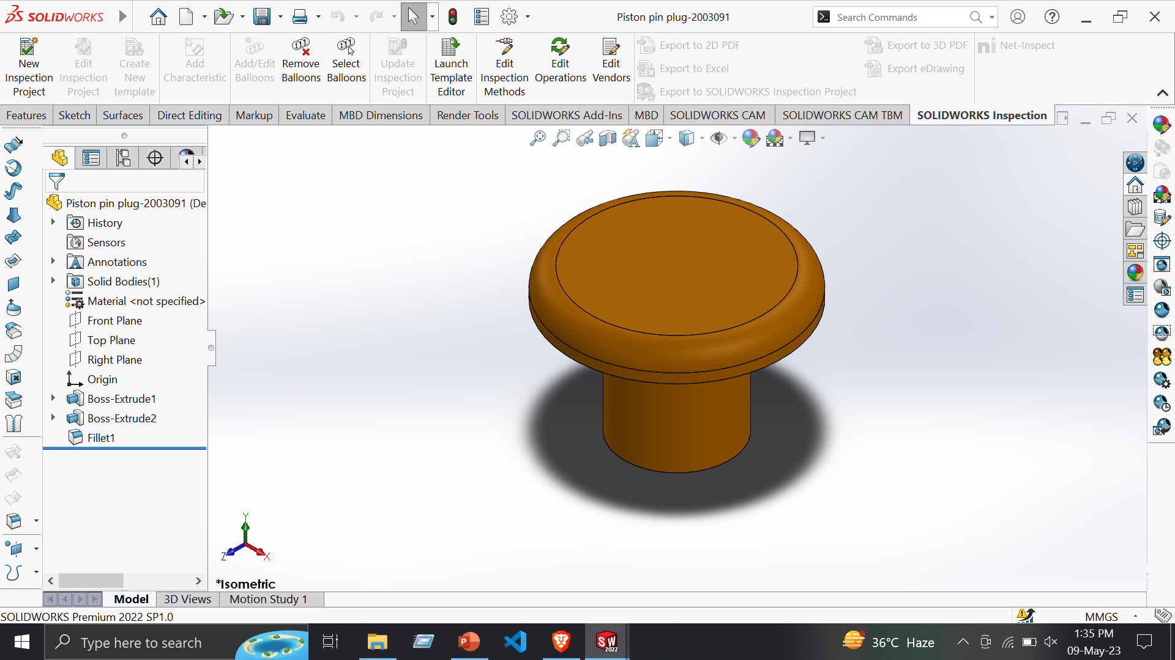
Part 6: Piston pin plug
Features:
Extruded Boss/Base
Fillet
Tools:
Line
Circle
Smart Dimension

Slide 37
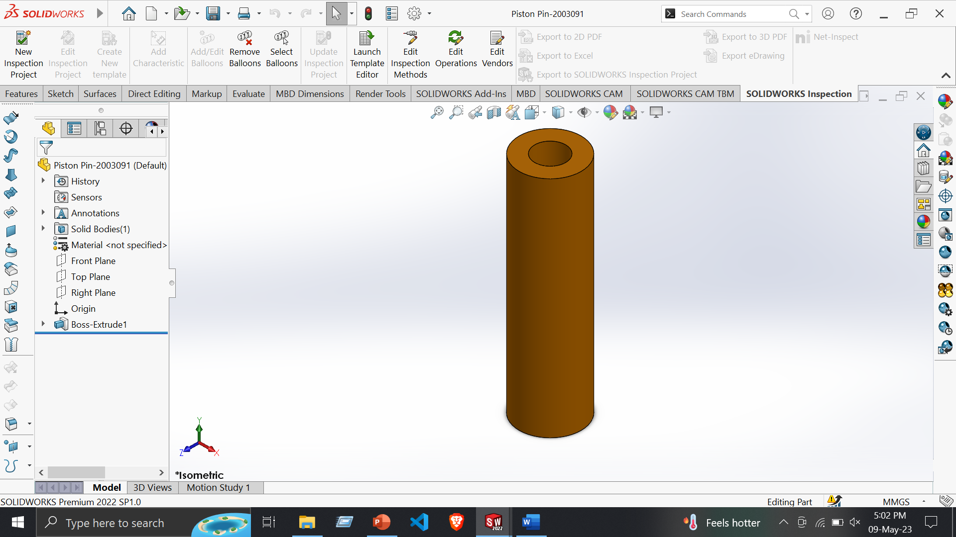
Part 7: Piston Pin
Features:
Extruded Boss/Base
Extruded Cut
Tools:
Line
Circle
Smart Dimension

Slide 38
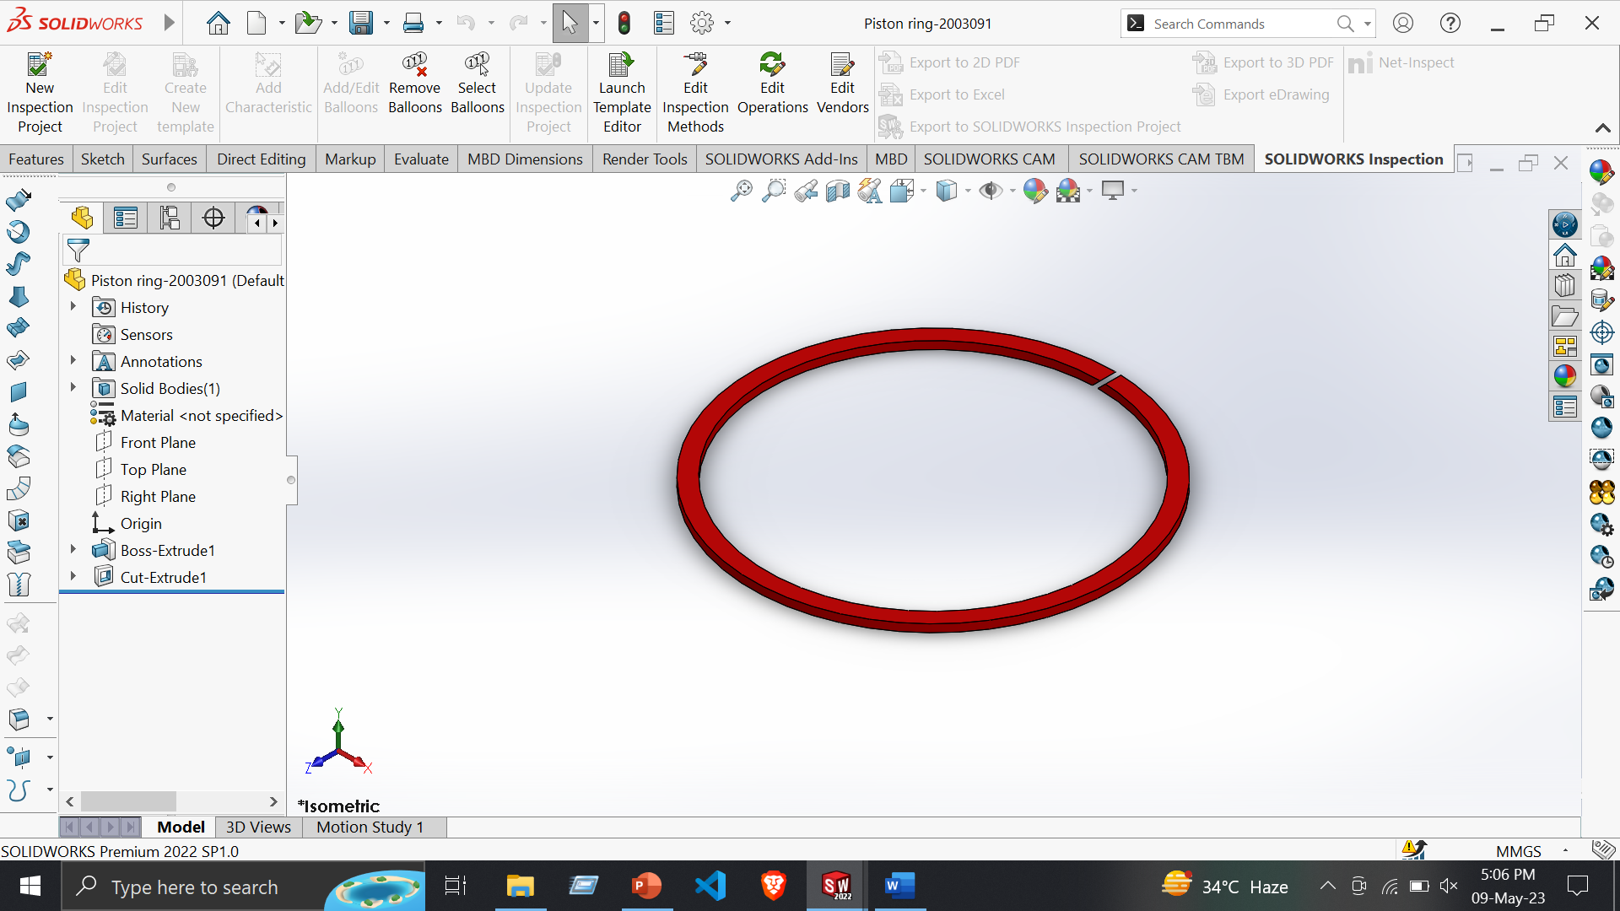
Part 8: Piston ring
Features:
Extruded Boss/Base
Extruded Cut
Tools:
Line
Circle
Smart Dimension

Slide 39
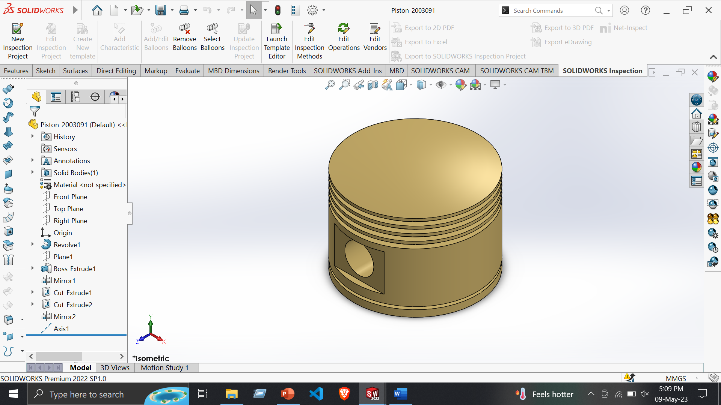
Part 9: Piston
Features:
Extruded Boss/Base
Revolved Boss/Base
Extruded Cut
Fillet
Tools:
Line
Centerline
Circle
Construction Geometry
Smart Dimension

Slide 40

Part 10: Upper Bush
Features:
Extruded Boss/Base
Extruded Cut
Tools:
Line
Circle
Smart Dimension

Slide 41
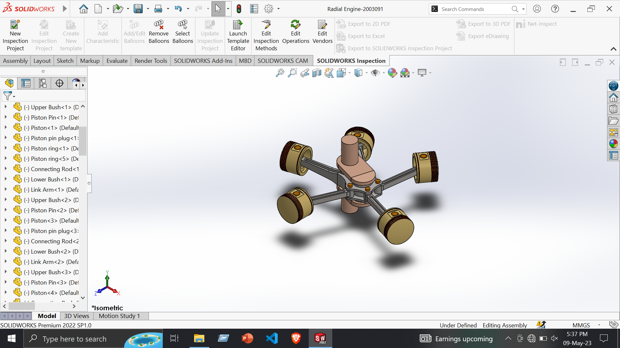
Radial Engine
Assembly –
Insert Component
Mate
Mirror
Copy With Mate
Coincide
Concentric

